Slide 1

Державна кібербезпека ≠ Кібербезпека держави Уроки #FRD
State Cybersecurity $≠$ Cybersecurity of the State Lessons of #FRD
Костянтин Корсун, Бережа Сек’юріті, директор та співзасновник
Kostiantyn Korsun, Berezha Security, Co-founder & CEO
BSides Kharkiv, June 8, 2019, Kharkiv, Ukraine

Slide 2
Structure
What is Responsible Disclosure and history of FuckResponsibleDisclosure (#FRD)
#FRD Paradox: I’m not a doctor, I’m a pain
The Story in Pictures: first splashes of #FRD, #FRD reaction, #FRD participants
Behavioral models during the #FRD: from hate to love
National Cybersecurity System: what we’ve got and how much we paid
#FRD efficiency: results of 23 Top Ukrainian Experts polling
Conclusions

Slide 3
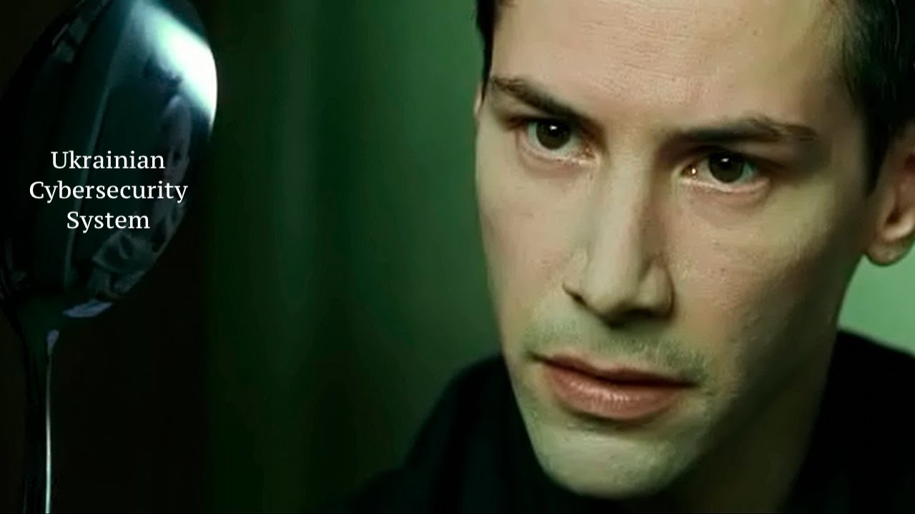
Intro
Cybersecurity is important. Do you agree?
Cybersecurity is a most important thing: do you agree?
There is no Cybersecurity System in whole Ukraine. Trust me.

Slide 4

What we actually have as a System?

Slide 5
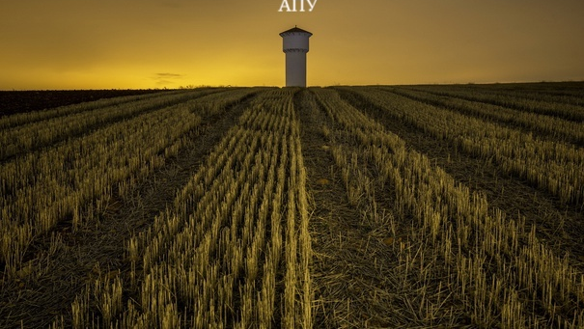

Slide 6
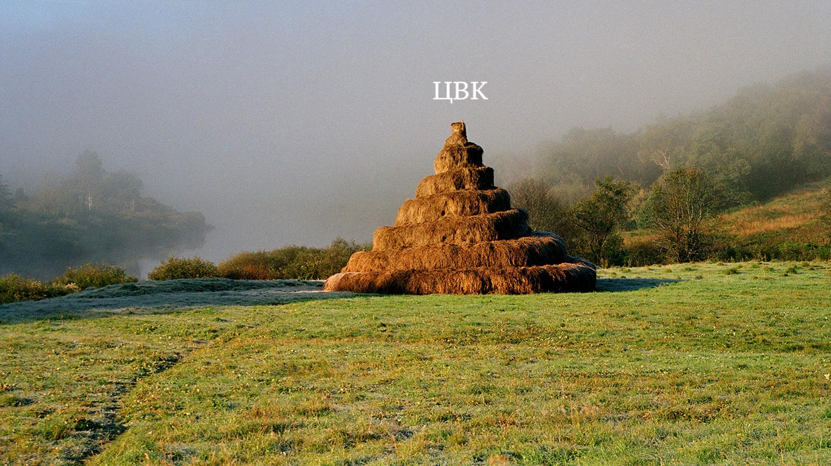

Slide 7

#FRD Paradox
There is No System, any evidences?
In October 2017 group of activists set up something under hashtag #FuckResponsibleDisclosure, (#FRD)
Зневажаю_Відповідальне_Розкриття
What do those three words under the same # mean?

Slide 8

#FRD Paradox
Responsible Disclosure: a vulnerability is revealed to an owner, in a nonpublic way Shortcoming: low efficiency
Full Disclosure, Irresponsible Disclosure: a vulnerability is revealed to everyone, in a public way. Shortcoming : exploitation possibility, in fact assisting the offender
Bruce Schneier: "Full disclosure – the practice of making the details of security vulnerabilities public – is a damned good idea. Public scrutiny is the only reliable way to improve security, while secrecy only makes us less secure”
https://www.schneier.com/essays/archives/2007/01/schneier_full_disclo.html

Slide 9
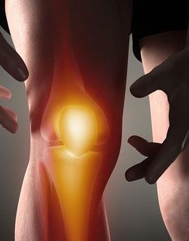
#FRD Paradox
#FRD important difference (and similarity): - public vulnerability statement BUT - no exploitation possibilities, like open disk share (exception: XSS);
Motivation: improvement of cybersecurity level at critical infrastructure objects AND public limelight through resonance;
#FRD activists: no solutions to problems, no service ;
#FRD activists: only point at problems, laughing on officials’ ignorance and critical infrastructure objects’ owners incompetence;
I’m not a doctor, I’m just a pain.

Slide 10

#FRD Paradox
How legal #FRD is?
How moral #FRD is?

Slide 11

The Story in Pictures
When #FRD started: October 6, 2017 with water supply company and energy company;
CERT-UA
Енергоатом (Energoatom, nuclear energy company): open access to local network;
Regional water supply company: : open access to local network;
КиївЕнерго (KyivEnergo, energy company): open access to local network;
Фінмоніторинг (Financial Monitoring Authority): archaic web site containing plenty of vulnerabilities

Slide 12
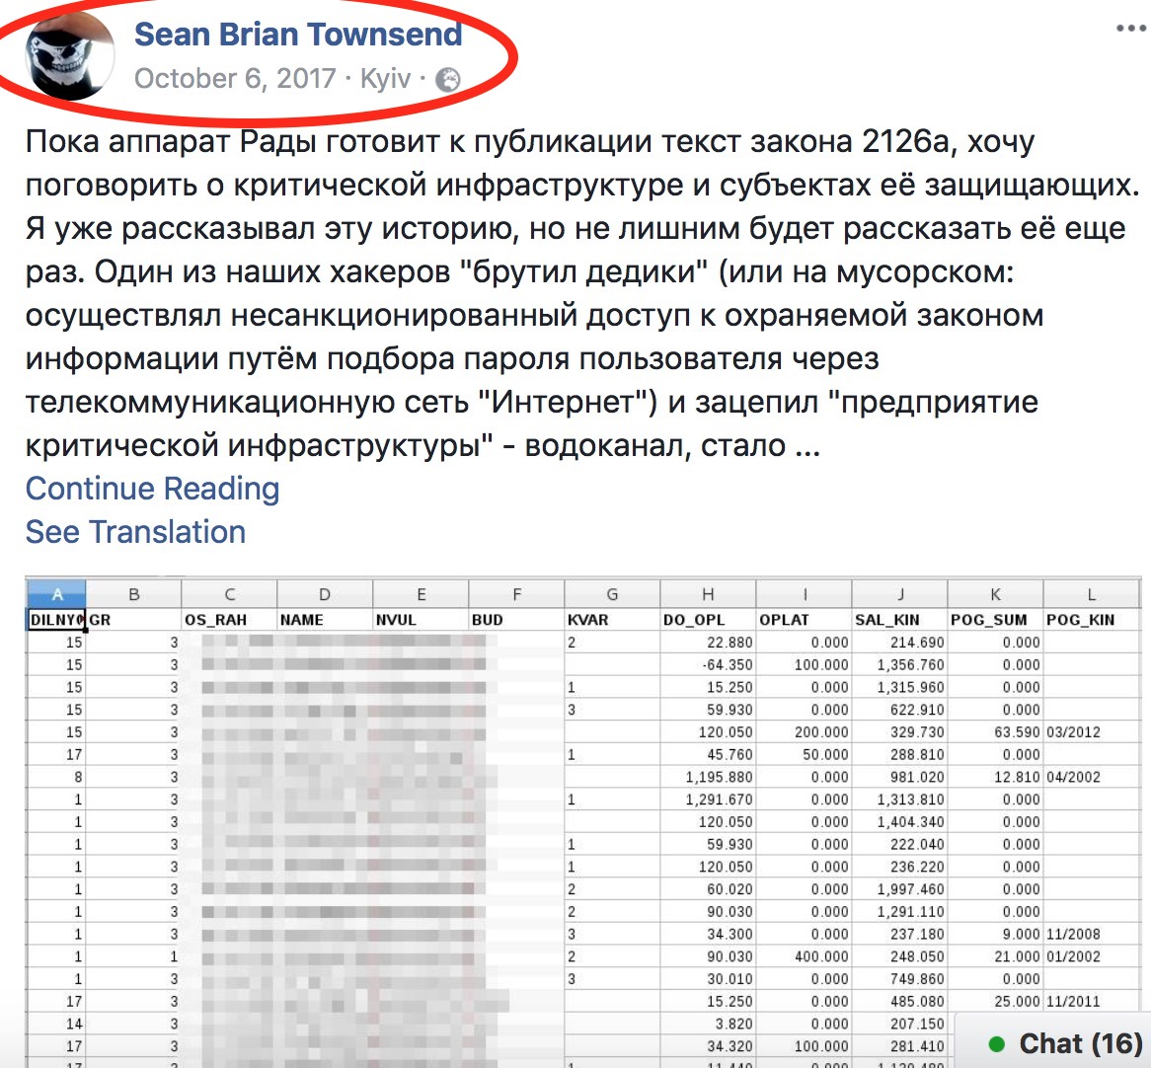

Slide 13
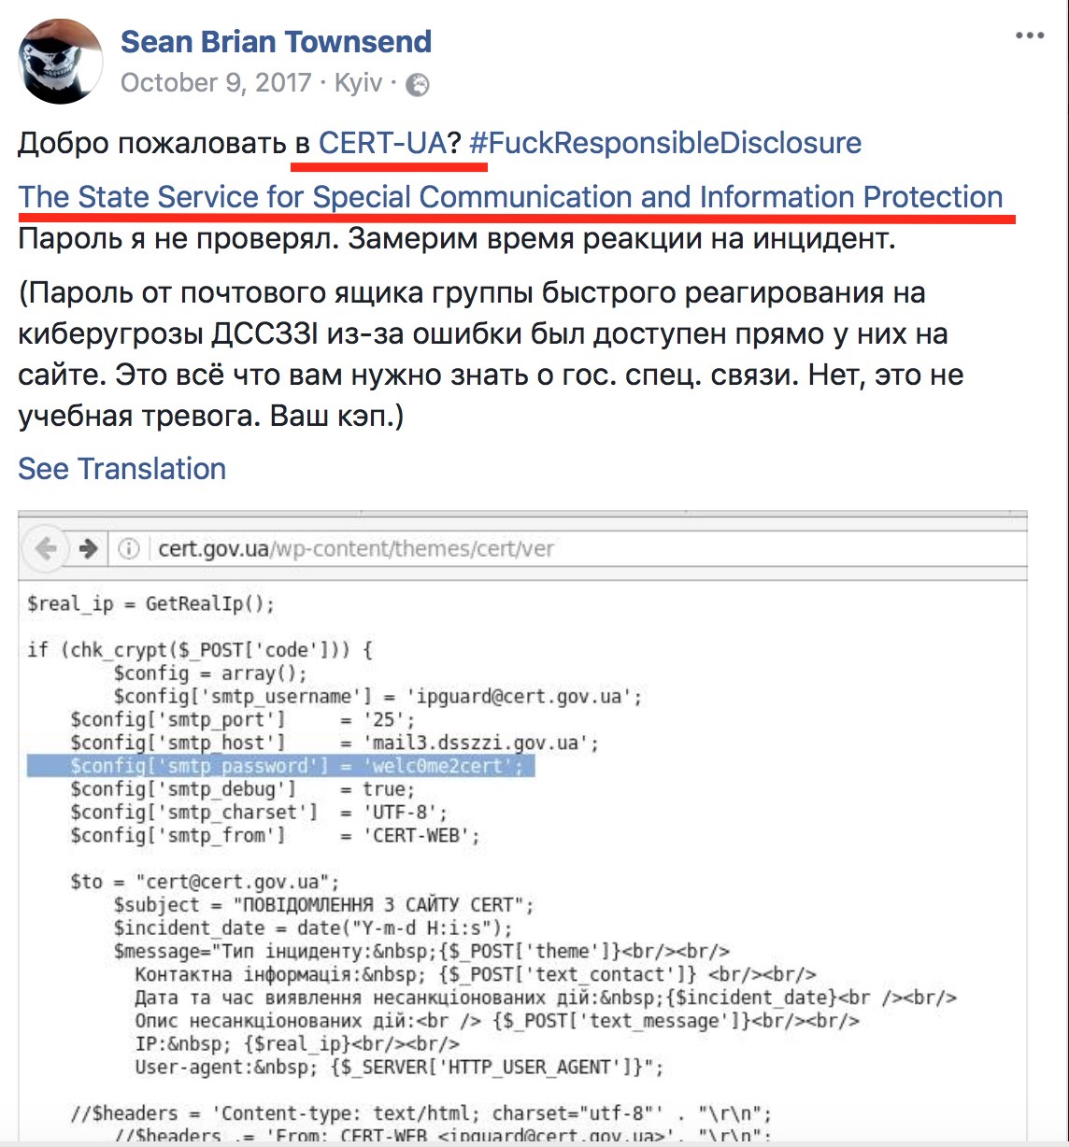

Slide 14
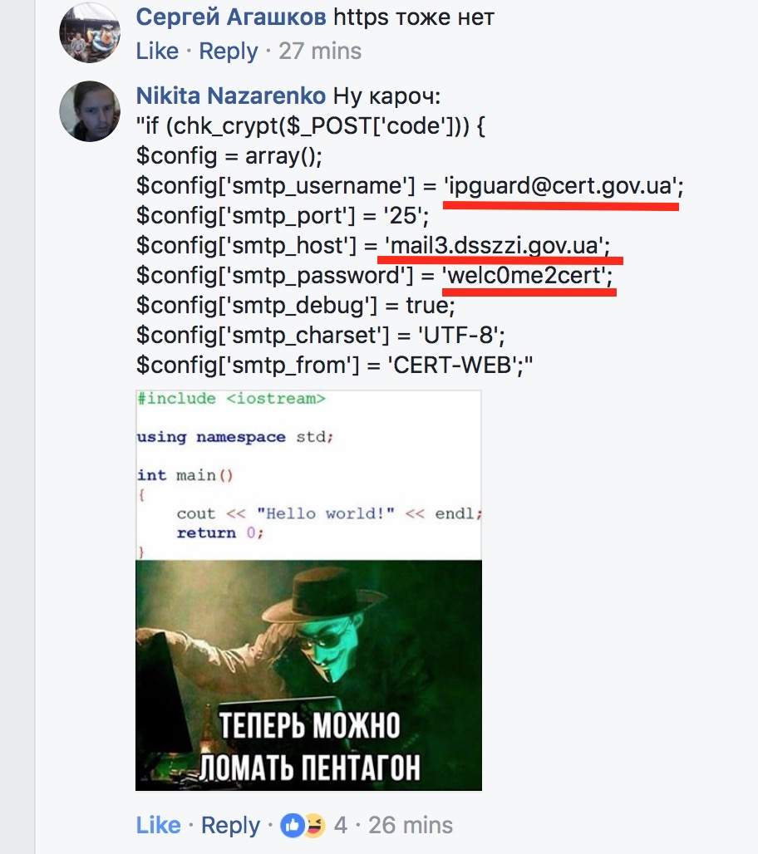

Slide 15
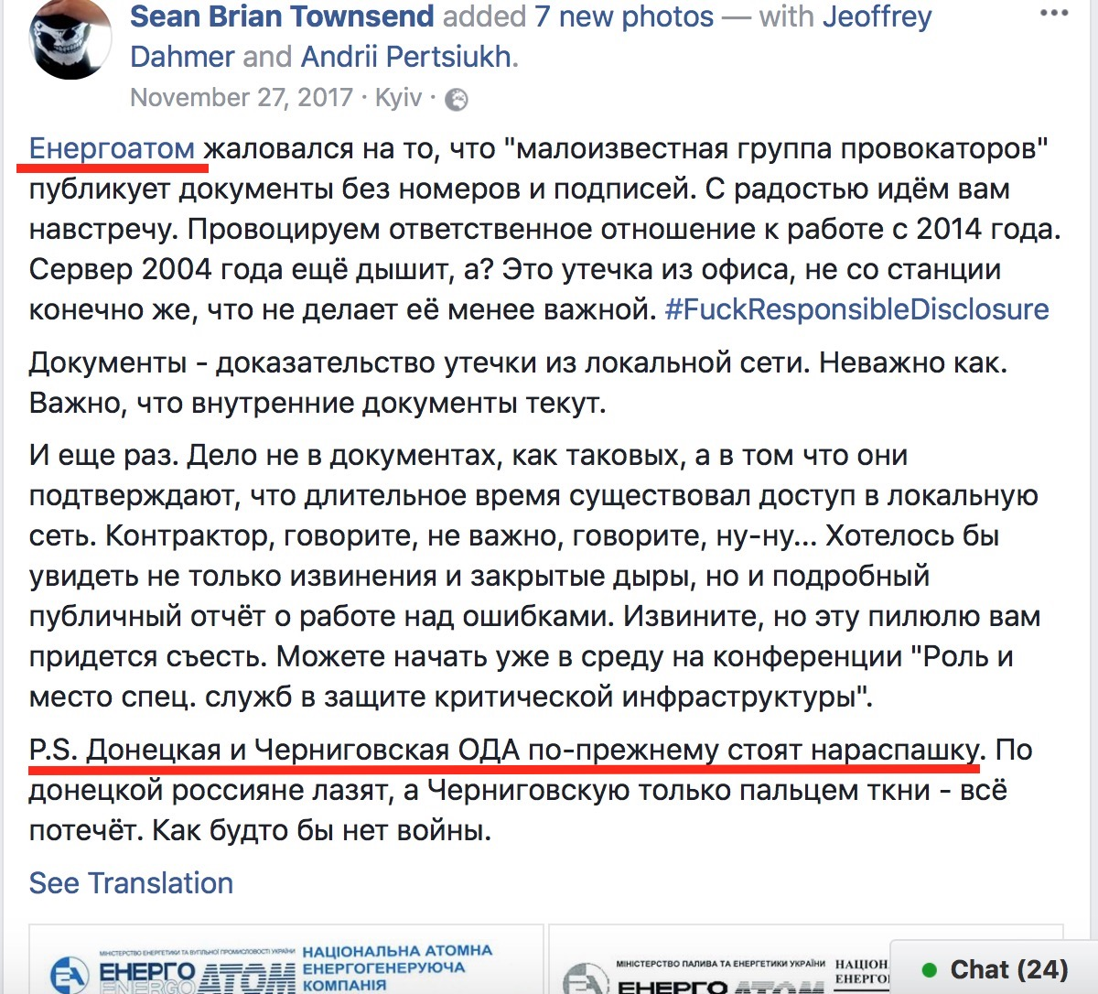

Slide 16
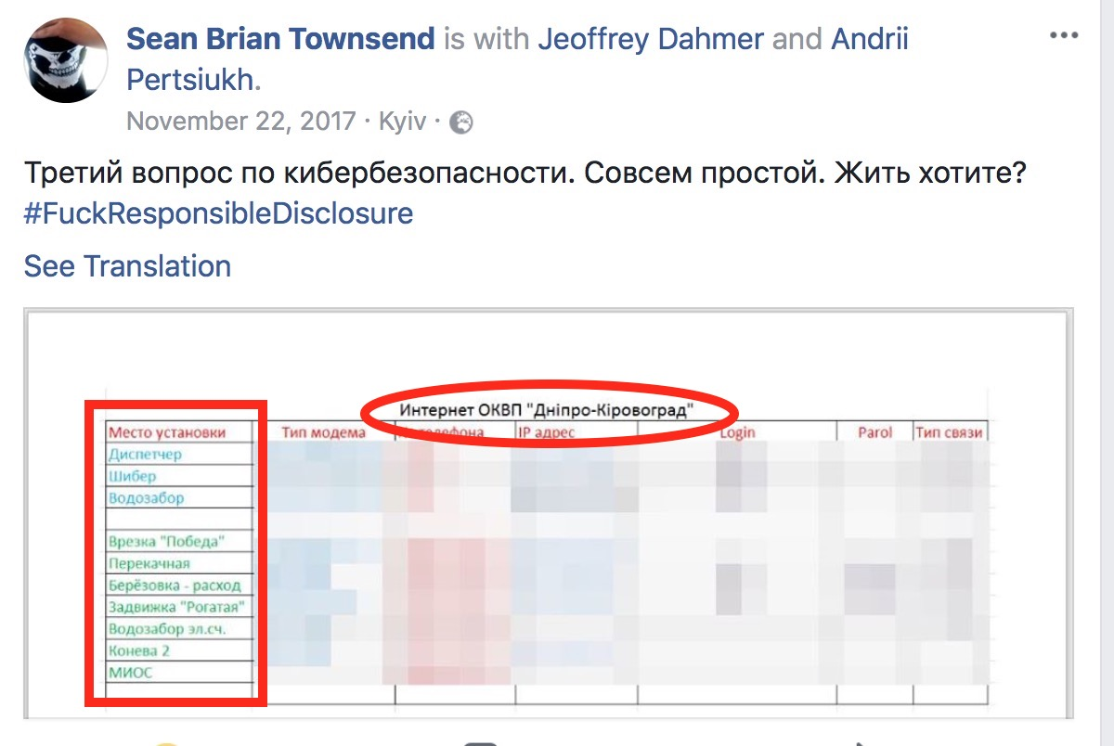

Slide 17
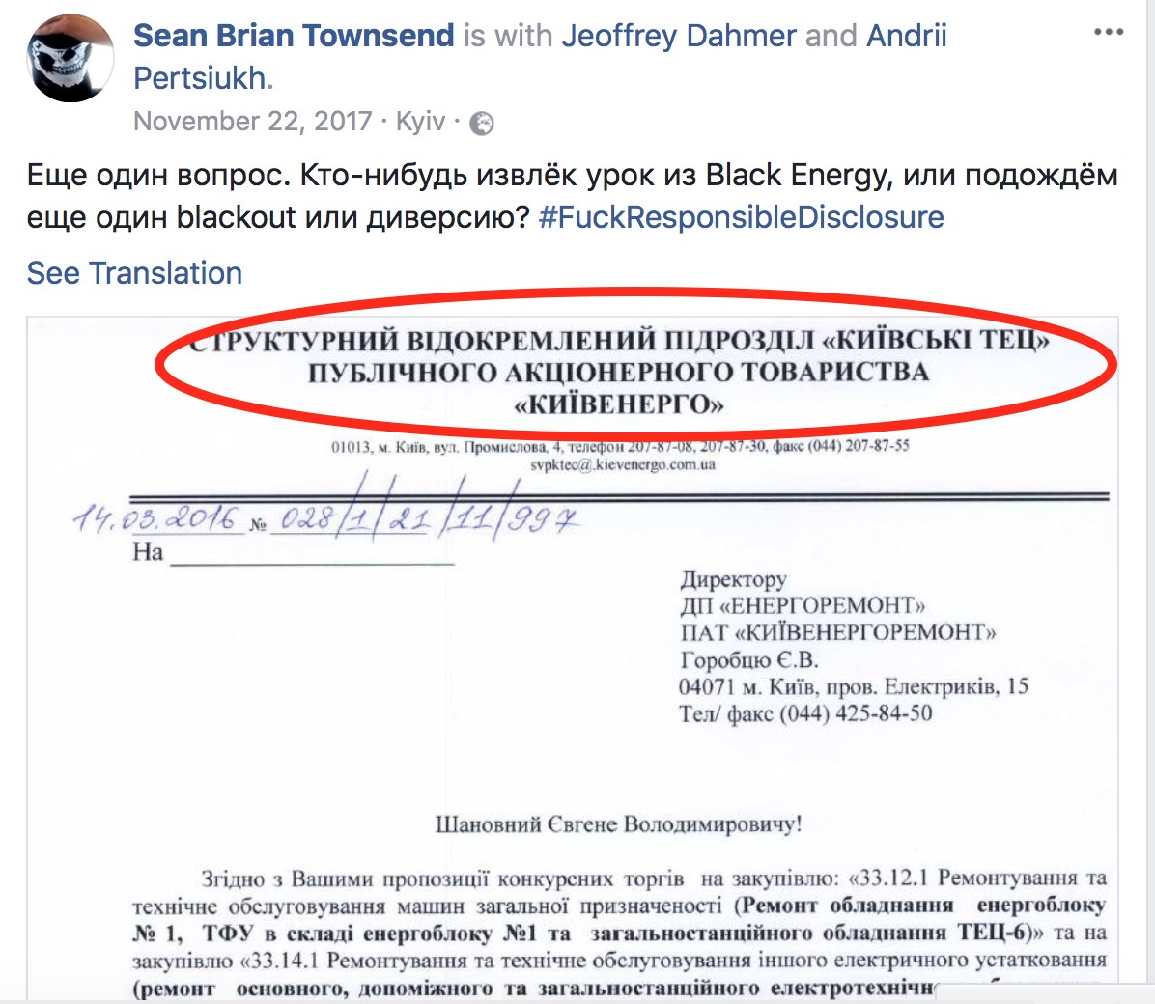

Slide 18
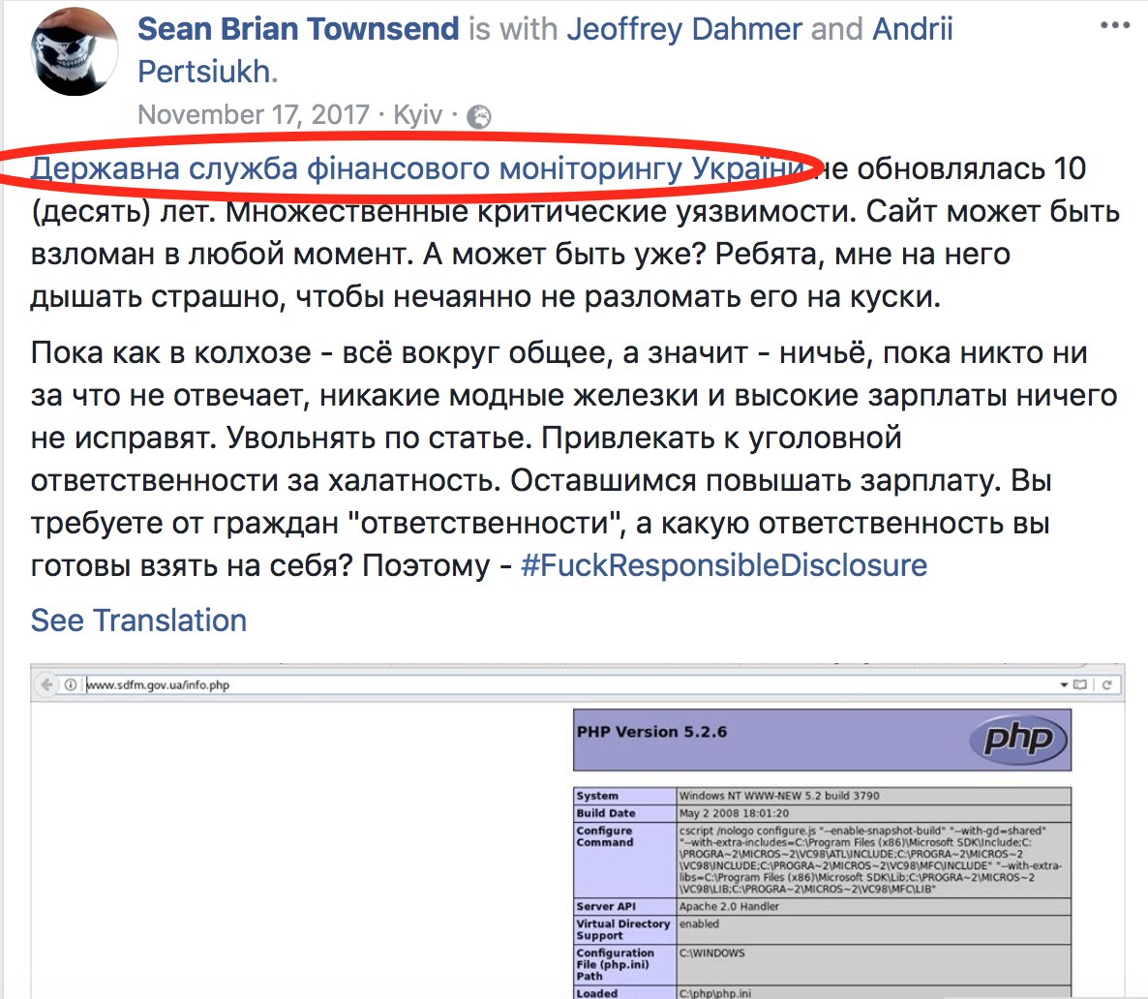

Slide 19
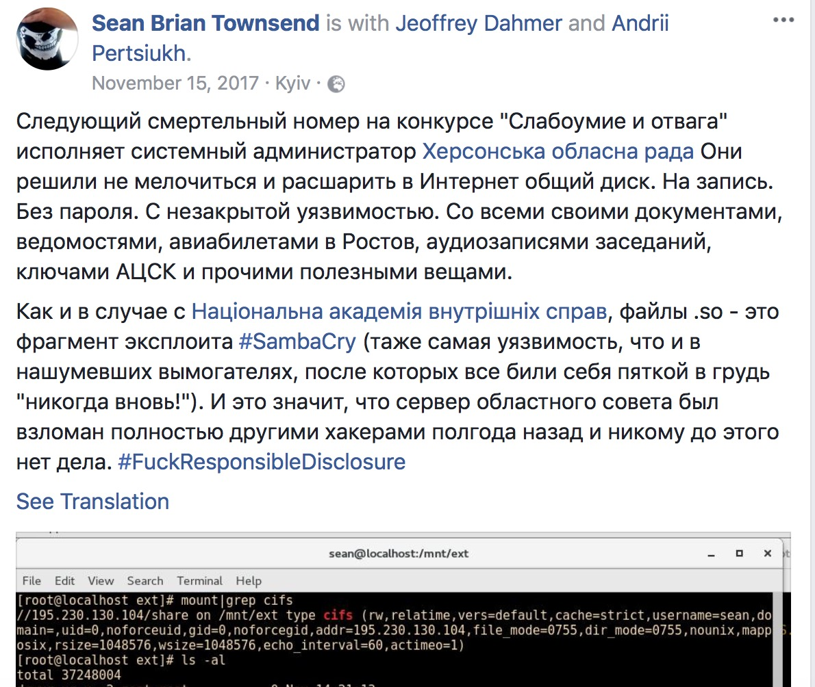
The Story in Pictures: KhOR
Херсонська обласна рада (Kherson Provincial Council): typical example
Problem: open access to internal network disk, without a password

Slide 20
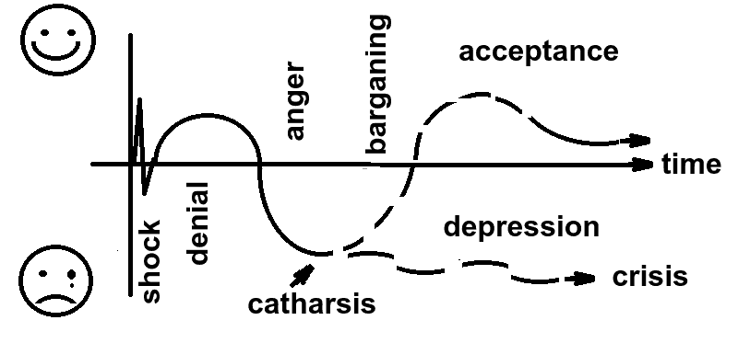
Kübler-Ross model: five stages of a grief

Slide 21
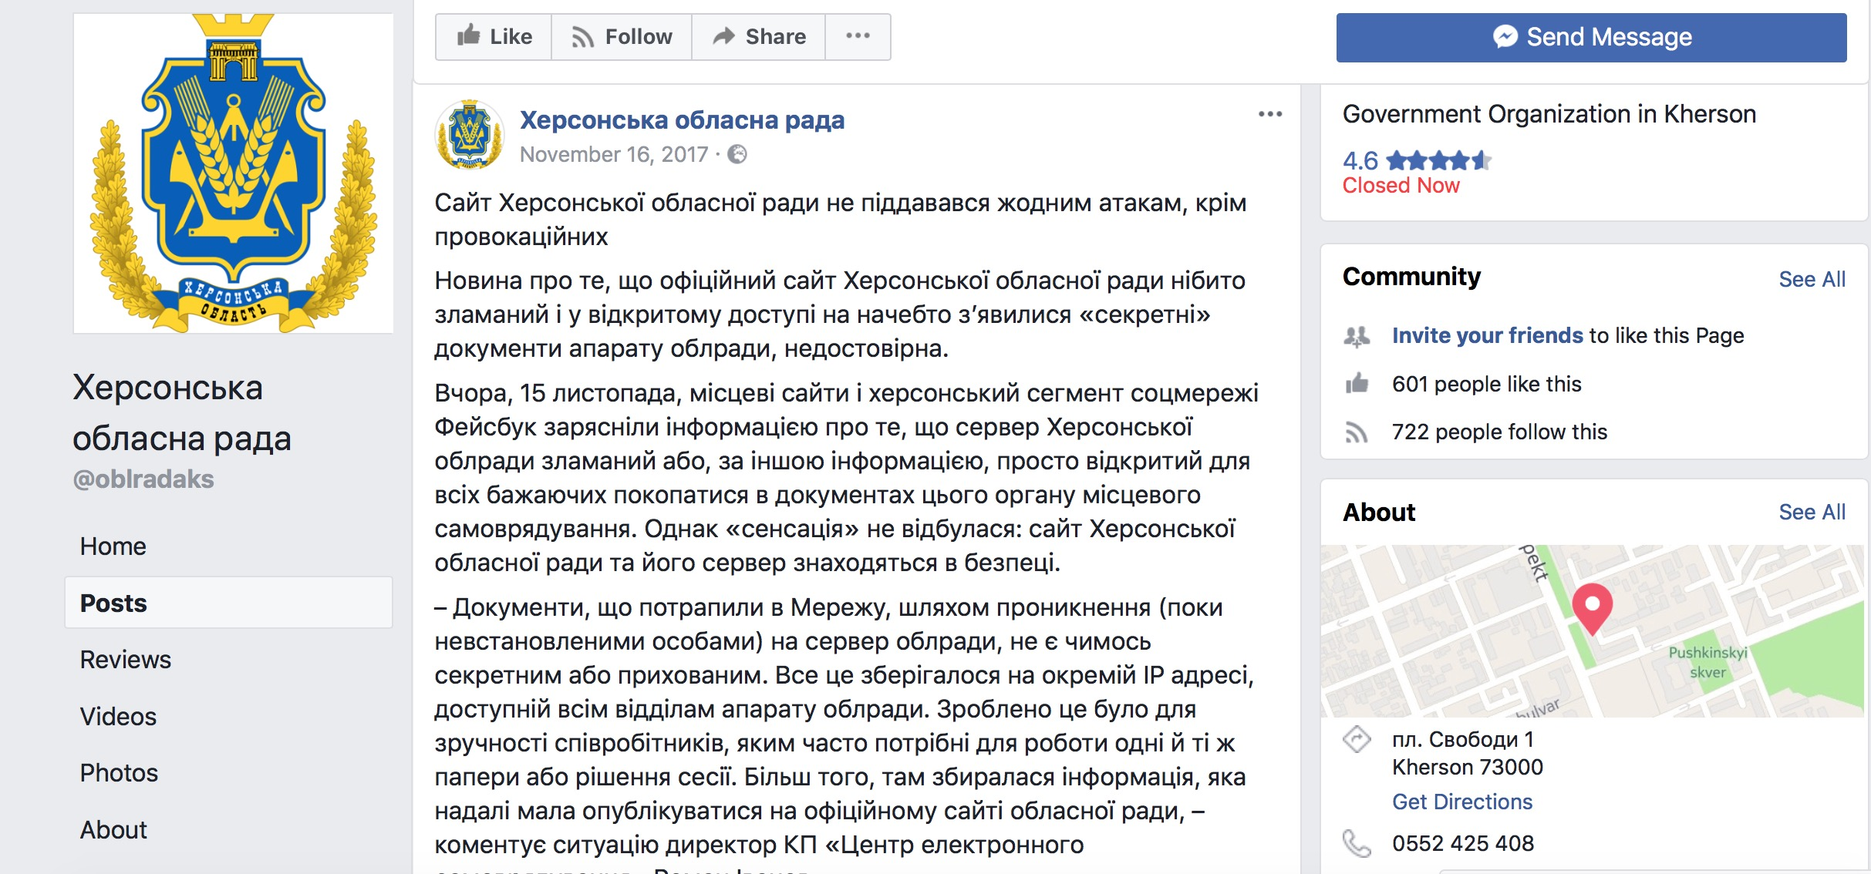
The Story in Pictures: KhOR
Shock – Denial - Anger:
1) It’s just a provocation
2) We haven’t been hacked
3) The documents are not secret
4) We complained to the police

Slide 22
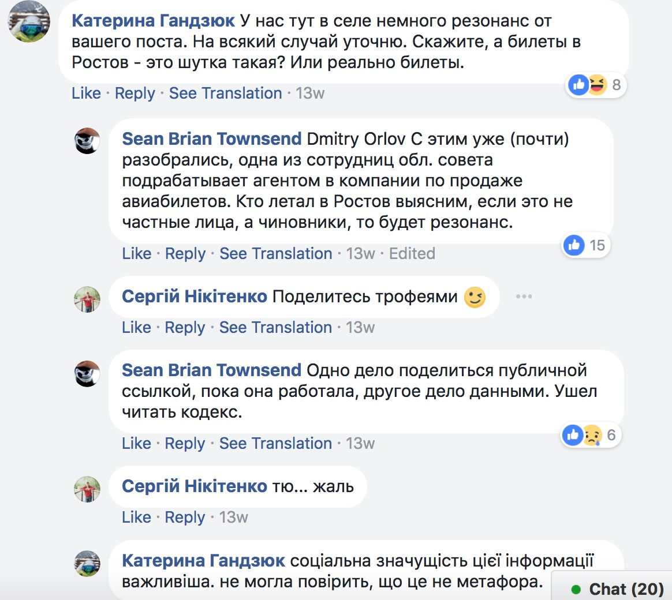
The Story in Pictures: KhOR
Bargaining: is it true that….?
Kateryna Handziuk

Slide 23
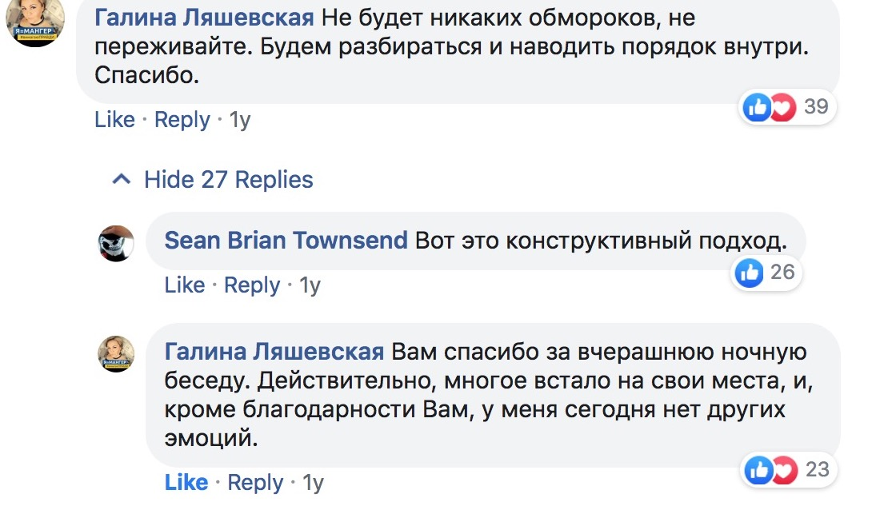

The Story in Pictures: KhOR
Depression – Acceptance: ignoring and/or thank you

Slide 24
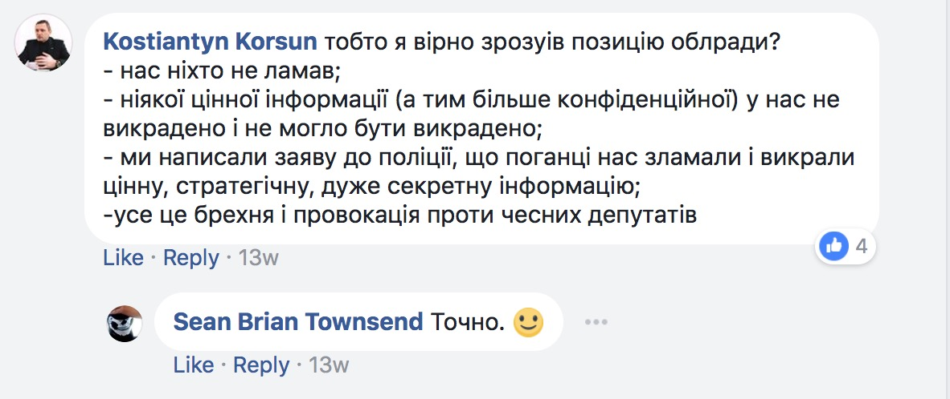
Typical #FRD reaction: other option
1) We haven’t been hacked
2) We don’t have any critical/secret information
3) We complained to the police
4) It was customized attack from our competitors

Slide 25



Typical #FRD reaction
Shame on you! BUT Probably the problem needs to be solved

Slide 26
Most prominent #FRD cases
43 most prominent cases
(from most important)
State and public authorities: 27
Центральна виборча комісія
Державний реєстр виборців
Міністерство оборони України
Генеральна прокуратура України
РНБО
Міністерство юстиції України
Міністерство охорони здоров’я
Міністерство внутрішніх справ України
Міністерство енергетики та вугільної промисловості України

Slide 27
Most prominent #FRD cases
Білоцерківський відділ поліції Національної поліції
Державна регуляторна служба України
Конституційна комісія при Президентові України
Державна служба України з лікарських засобів та контролю за наркотиками
Державна служба статистики України
НКРЕП (Національна комісія, що здійснює державне регулювання у сферах енергетики та комунальних послуг
Державна служба фінансового моніторингу України

Slide 28
Most prominent #FRD cases
Судова влада України
Волинська ОДА
Донецька ОДА
Чернігівська ОДА
Херсонська обласна рада
Черкаська обласна рада
районні державні адміністрації Хмельницької та Харківської областей

Slide 29
Most prominent #FRD cases
Critical infrastructure objects:
Енергоатом
Південно-Українська АЕС
Укрпошта
Укренерго
Укрзалізниця
Київпастранс
Водоканал «Дніпро-Кіровоград»
Київенерго
ПАО «Завод Маяк»
Державна фірма “Укрінмаш» («Укроборонпром»)
КБ «Південне»
Комунальний концерн «Центр комунального сервісу»
Львівська залізниця

Slide 30

Most prominent #FRD cases
Приватні компанії:
Метінвест
Київстар
велика аудиторська компанія

Slide 31
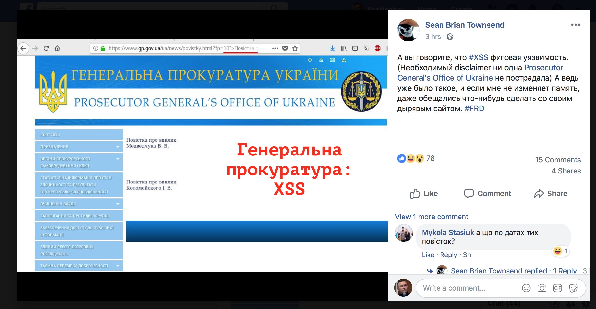
And more screenshots…

Slide 32
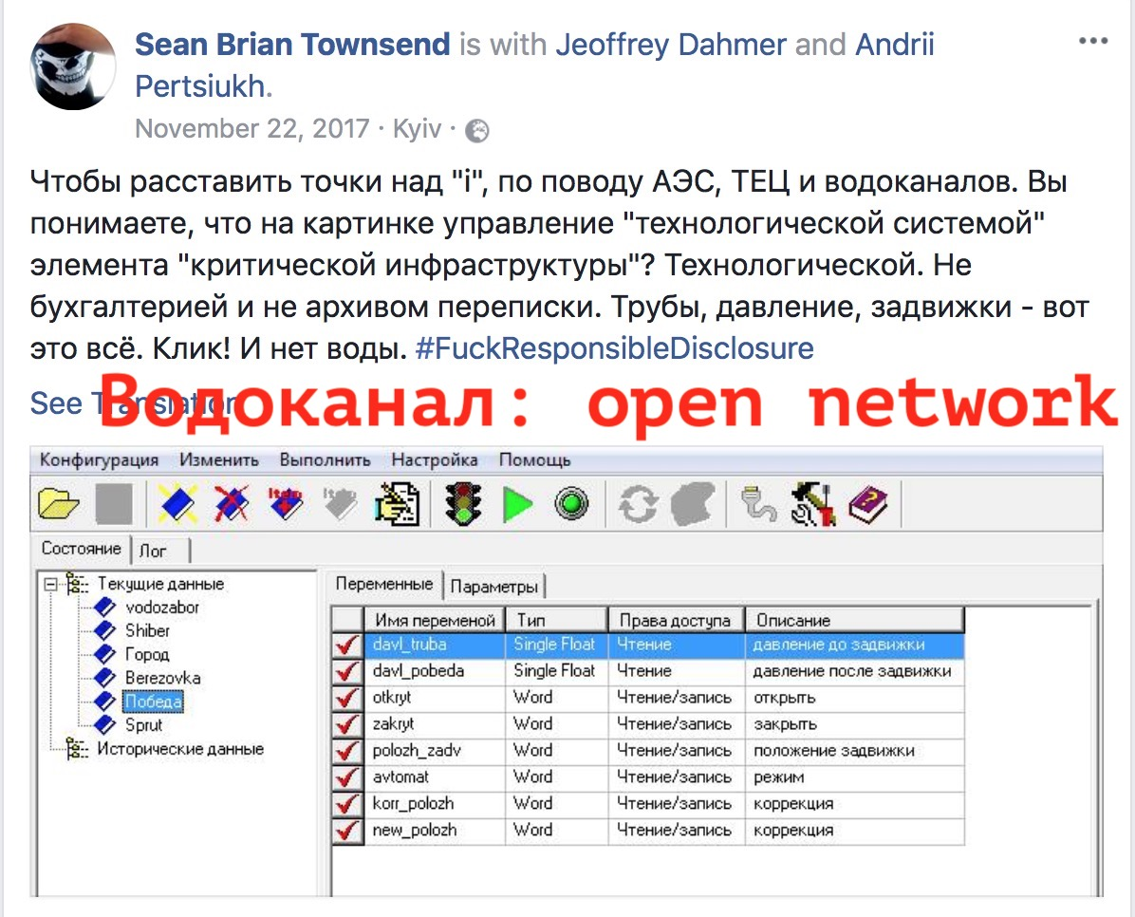

Slide 33
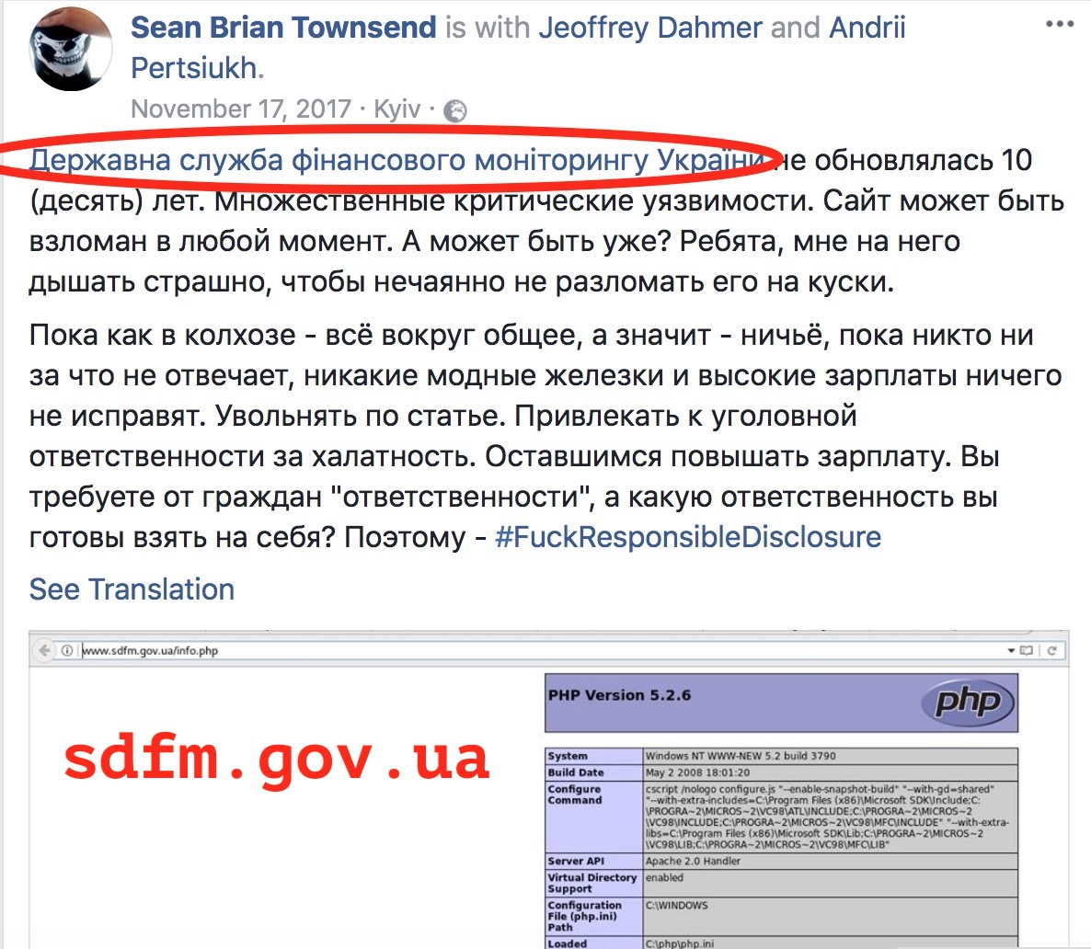

Slide 34
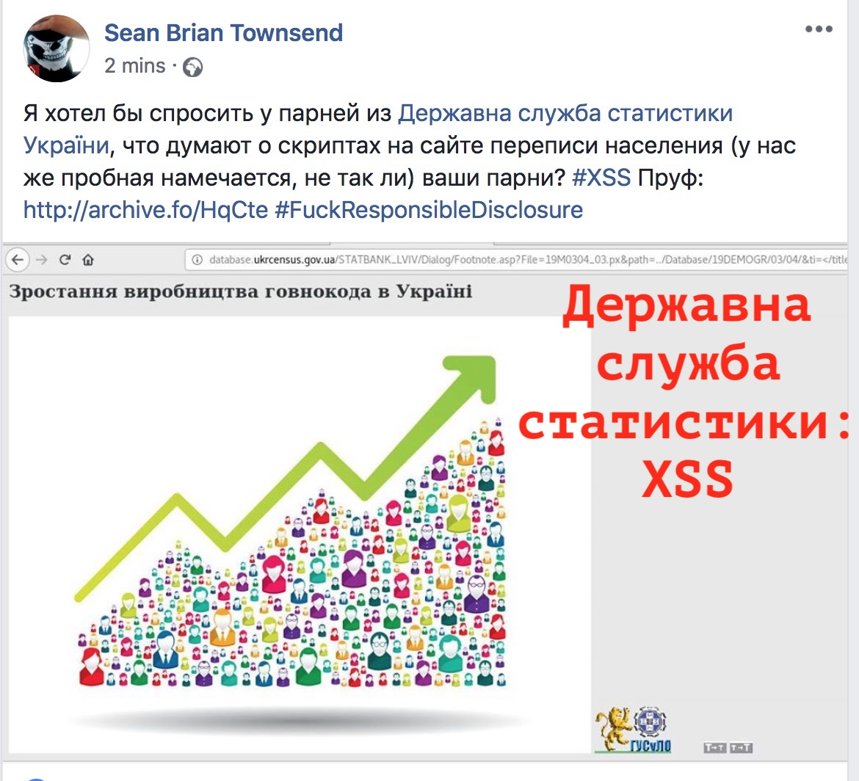

Slide 35
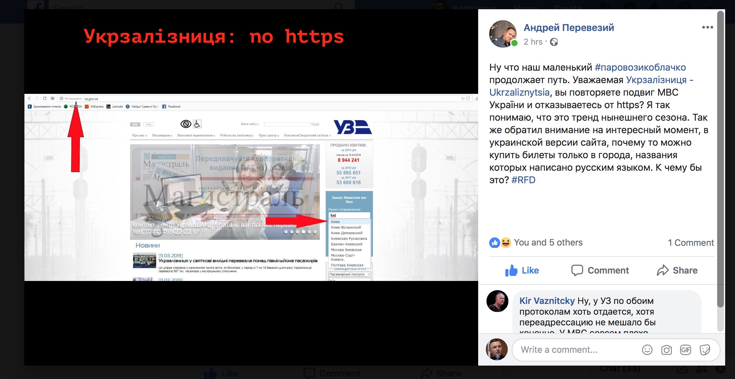

Slide 36
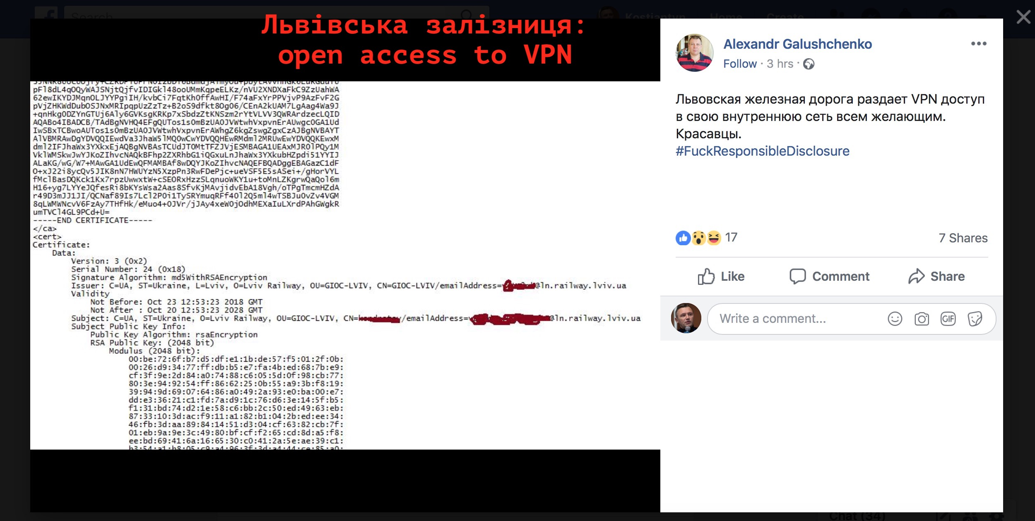

Slide 37
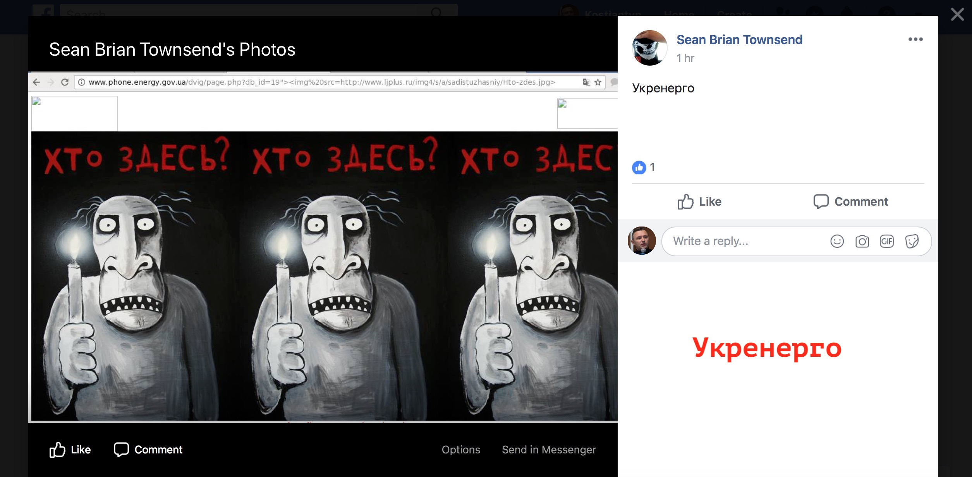

Slide 38
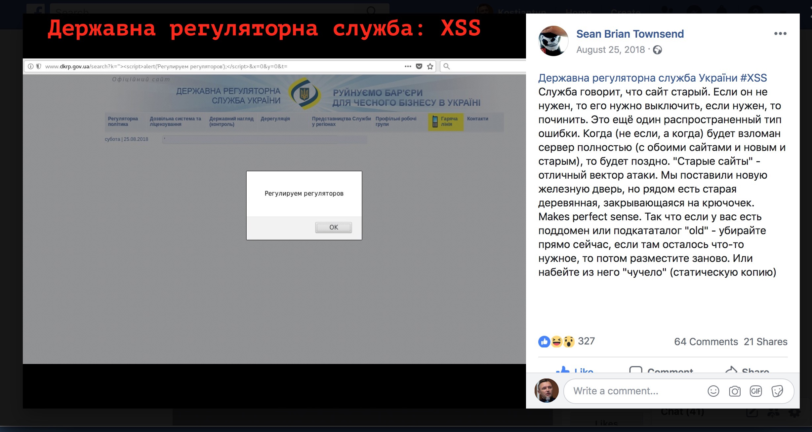

Slide 39
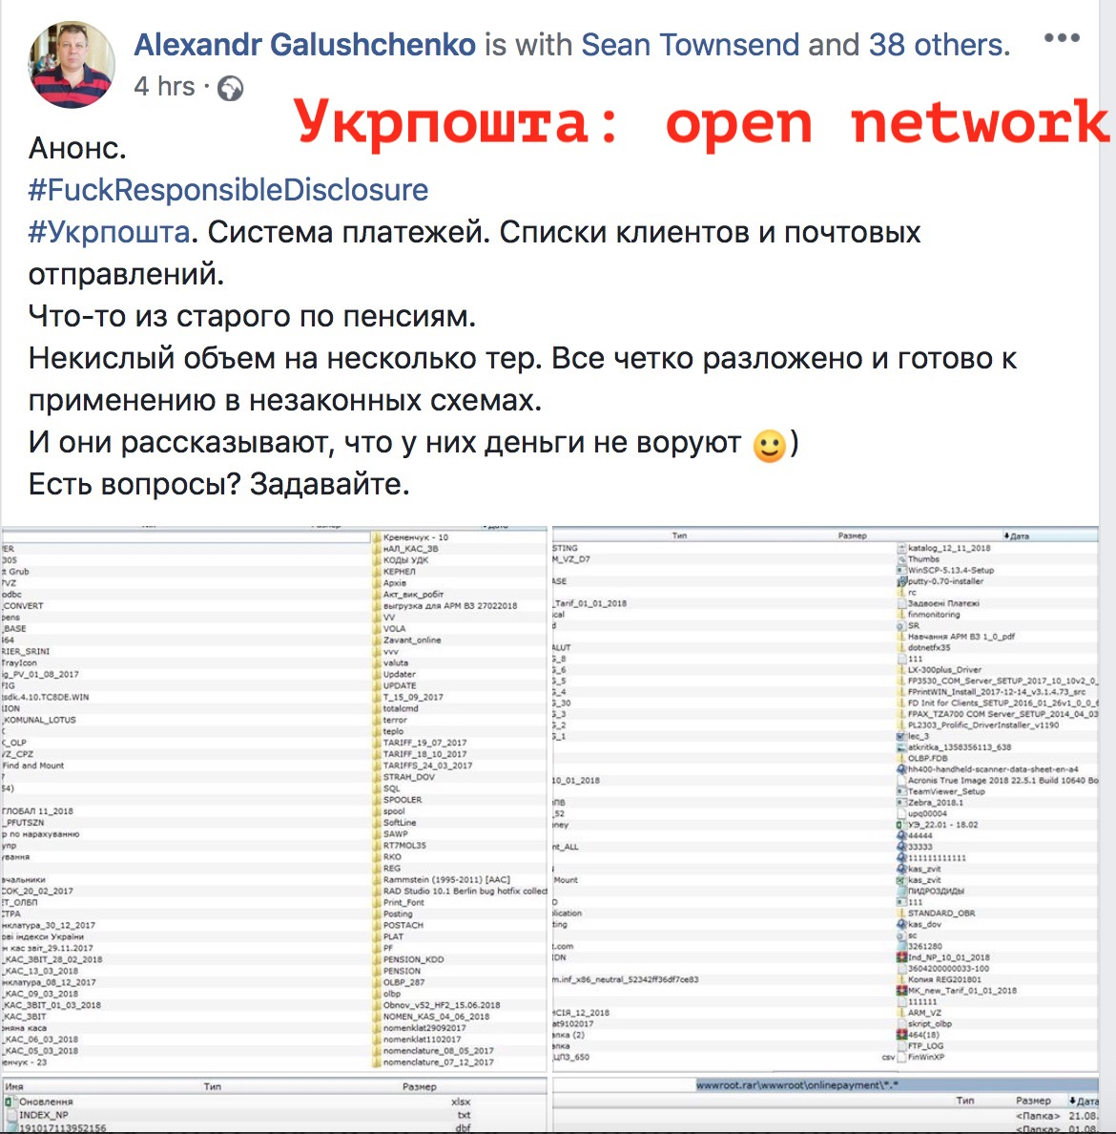

Slide 40
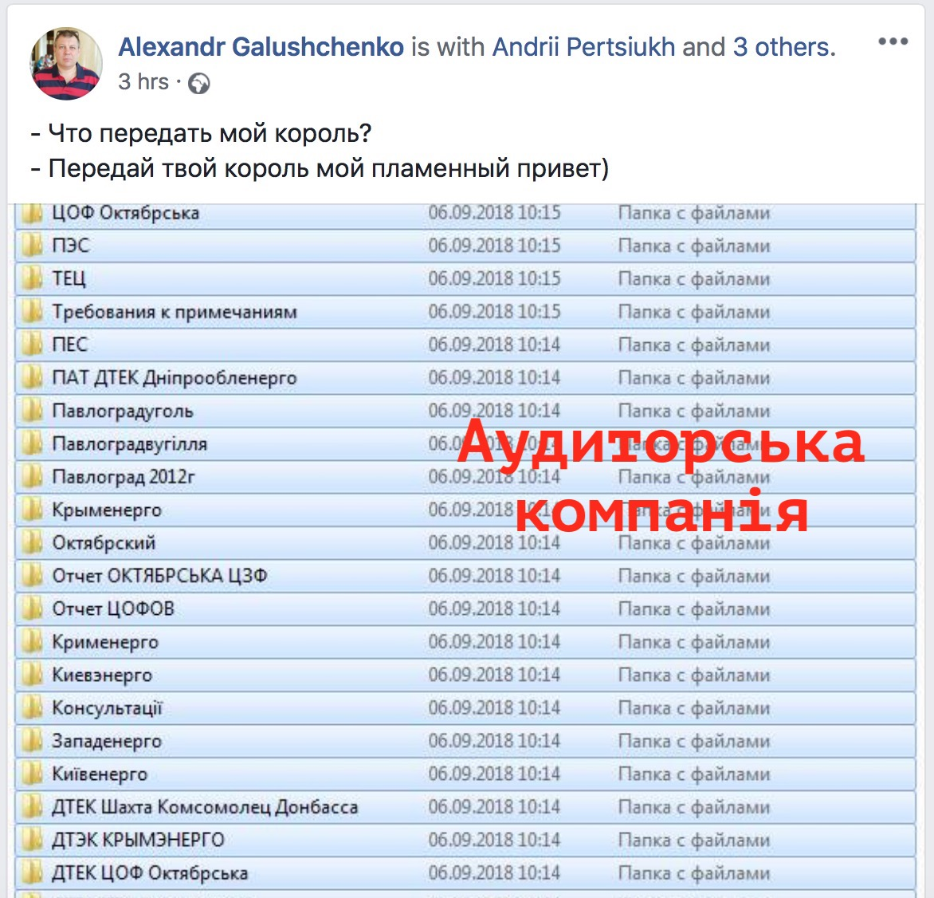

Slide 41
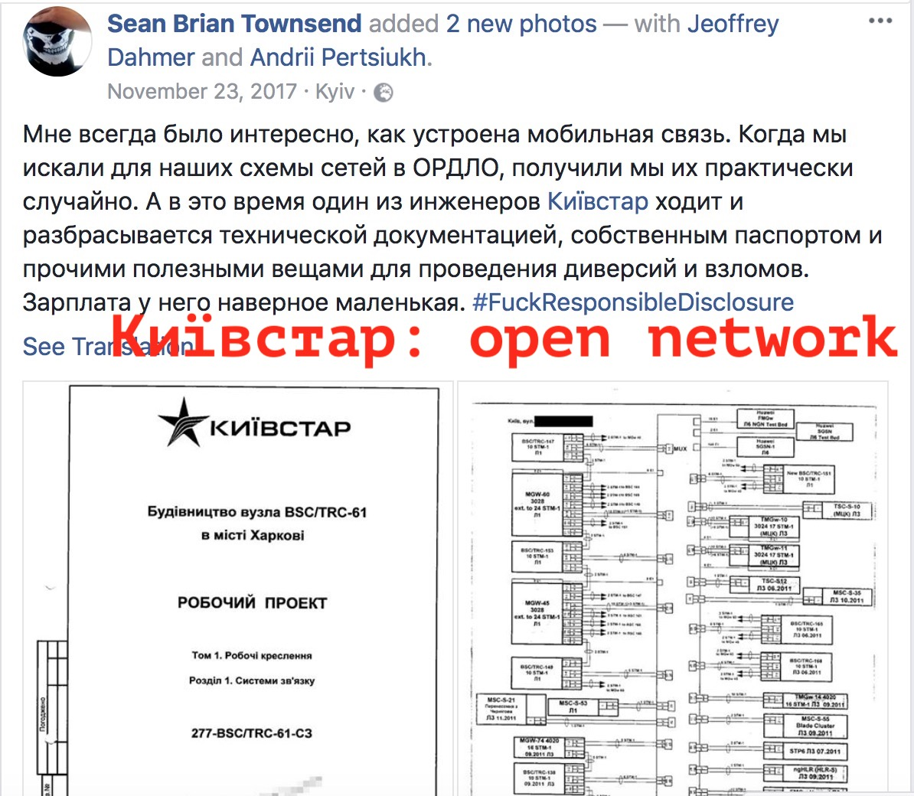

Slide 42
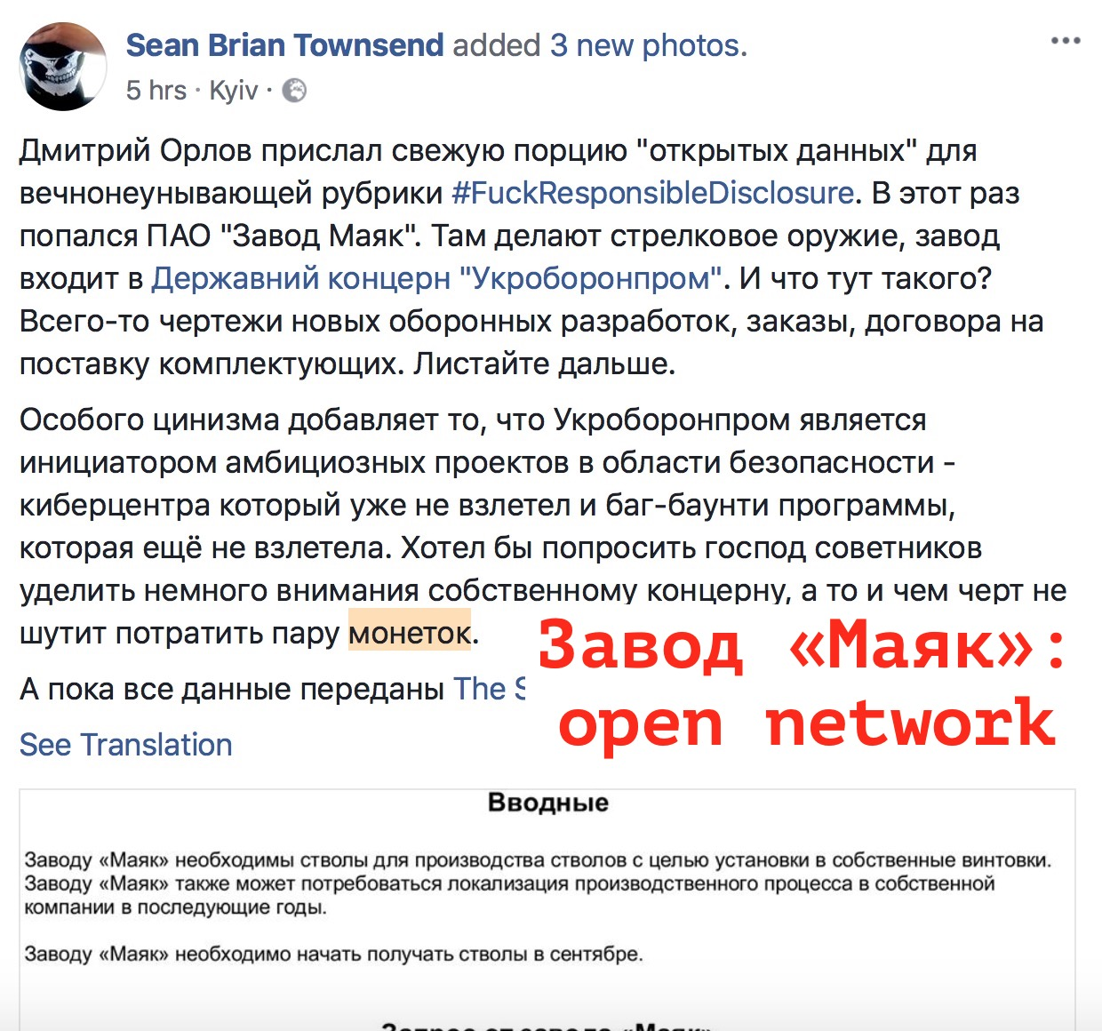

Slide 43
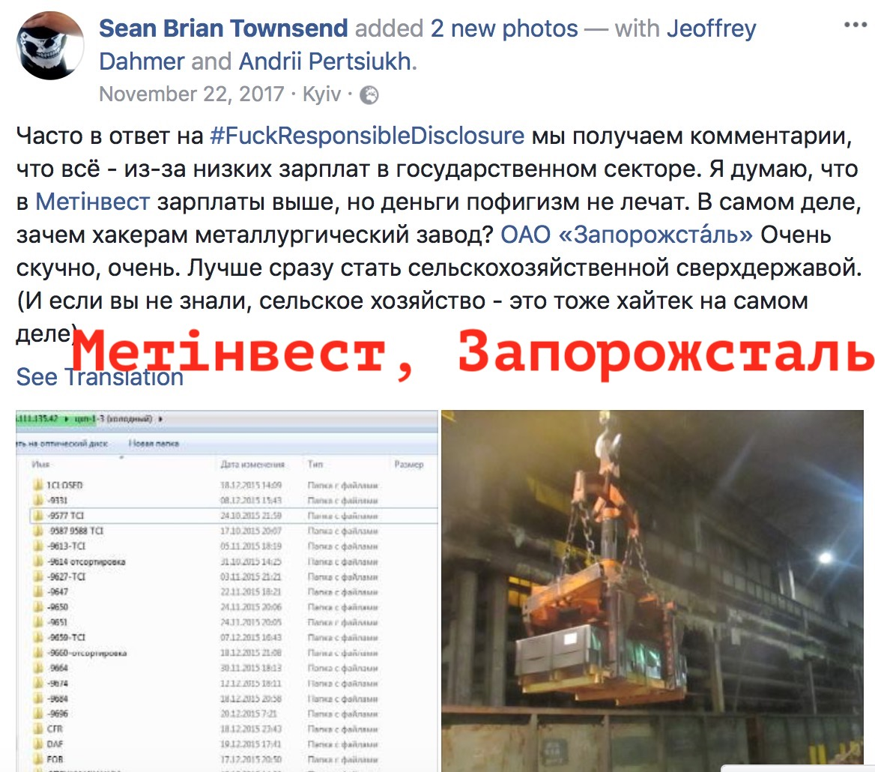

Slide 44
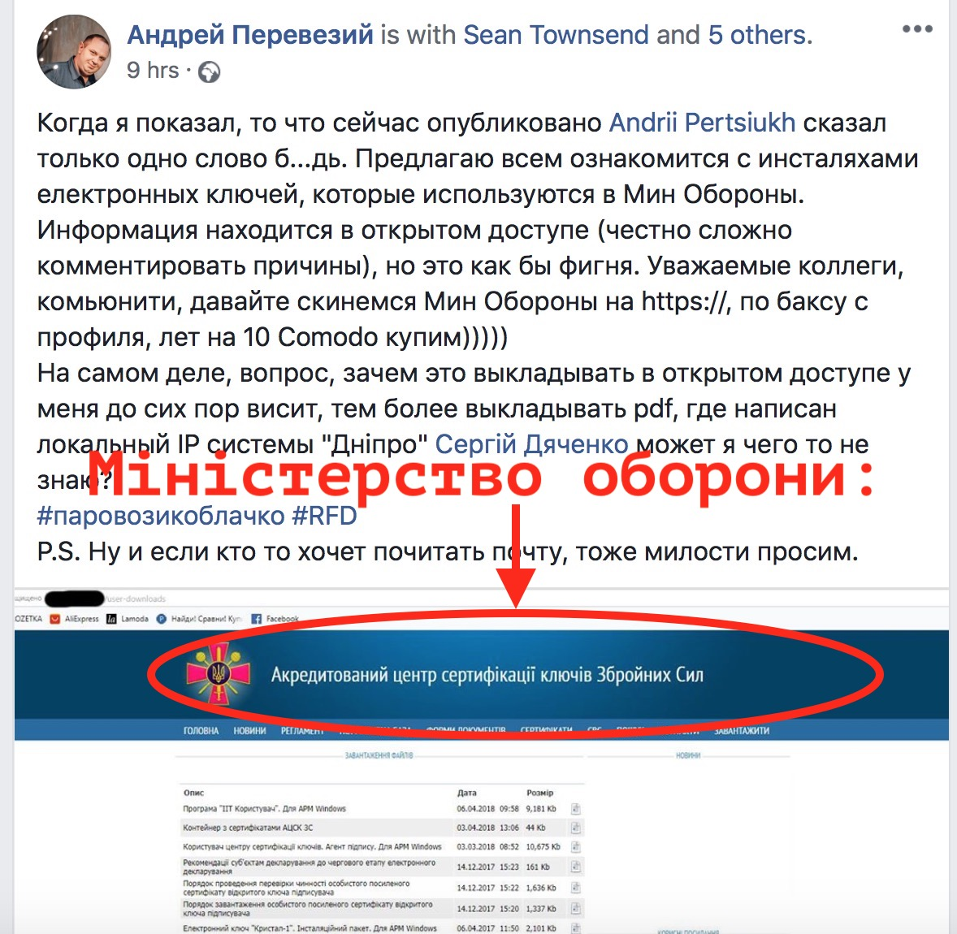

Slide 45
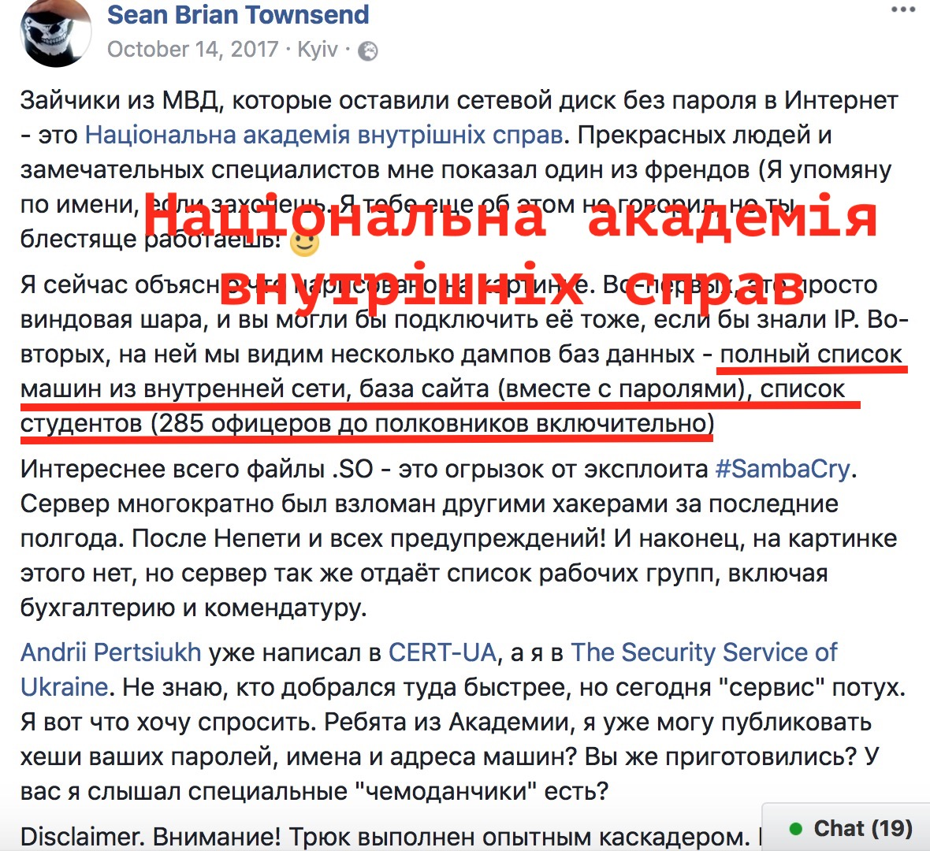

Slide 46
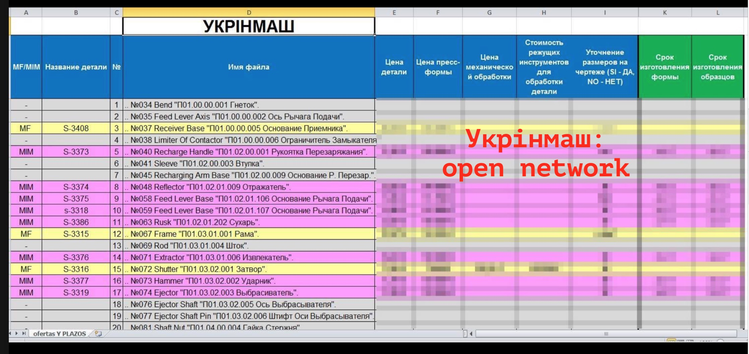

Slide 47
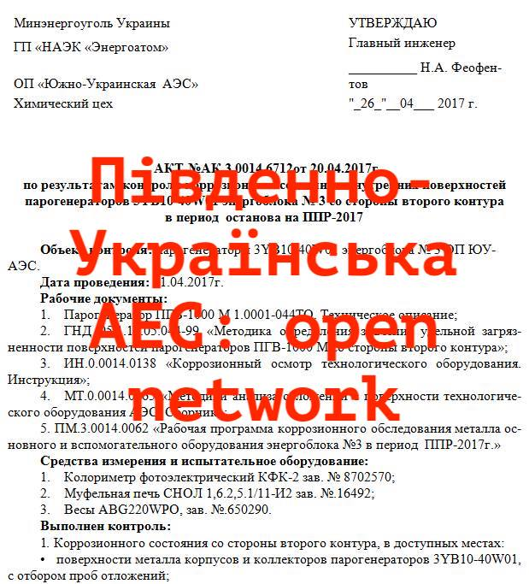

Slide 48

Most popular vulnerabilities:
Open network disk, without password
XSS
Outdated CMS
Web-servers without updates + plenty of vulnerabilities
Old web sites’ versions on sub-domains of .gov.ua
SQLi
HTTP instead of HTTPS

Slide 49
Outstanding #FRD activists
Sean Brian Townsend
Дмитрий Орлов
Jeoffrey Dahmer
Yehor Papyshev
Andrii Pertsiukh
Kir Vaznitsky
Сергій Дяченко
Aleksandr Galushchenko
Андрей Перевезий
Дякую!

Slide 50
‘National Cybersecurity System’
Seven public authorities are responsible for National Cybersecurity System:
РНБО, National Security and Defense Council. coordinator
Держспецзв’язку, SSSCIP
СБУ, Security Service of Ukraine
Кіберполіція, CyberPolice
НБУ, National Bank of Ukraine
Міністерство оборони/ГШ ЗСУ, Ministry of Defense, General Staff
Розвідувальні органи, Intelligence Agencies
Three of them are objects of #FRD
Other ones are potential objects

Slide 51
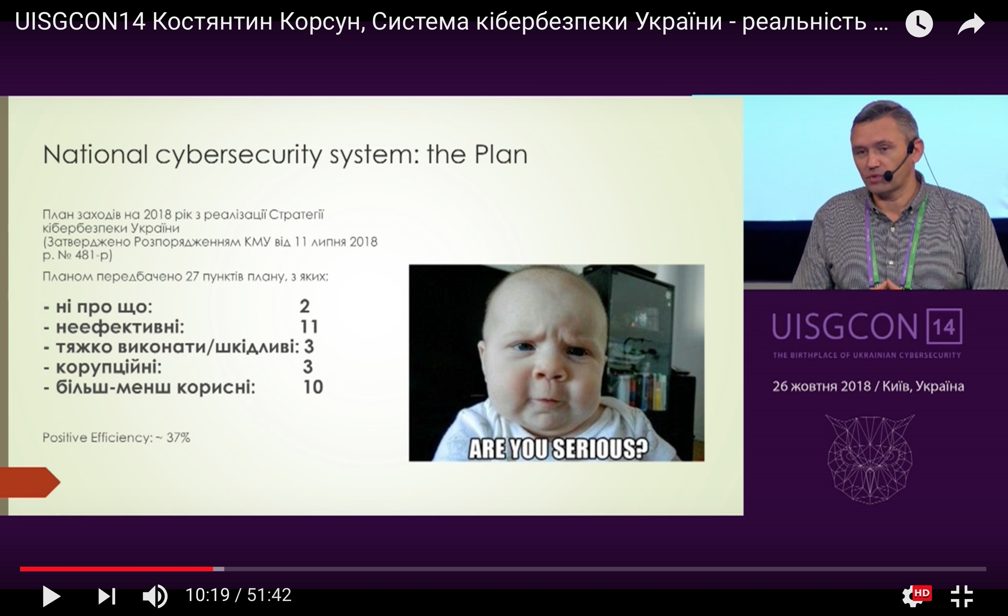
‘National Cybersecurity System’: money
$125 million per year for SSSCIP
SSU: $17 million
CyberPolice: $700k
NBU, MoD, Intel: N/A
Total: ? ? ? ? ? ?
On National Cybersecurity System in details: UISGCON14, Костянтин Корсун, Система кібербезпеки України - реальність чи міф? https://www.youtube.com/watch?v=HerX0DDEaFs&t=9s

Slide 52
#FRD consequences
Tactical effects:
Resonance in media Discharges Budgets for cybersecurity Growing interest to cybersec industry Increasing number of professional certificates Better cooperation of Gov and Private sectors Is it objective or subjective? 23 Ukrainian cybersecurity Top-experts have been inquired.

Slide 53
#FRD consequences
Who are those 23 experts?
5 work in Gov sector
14 work at Private sector
4 independent experts (freelance, journalist)
8 work at critical infrastructure objects
2 females, 21 males
No one is #FRD activist
No one from CyberPolice

Slide 54
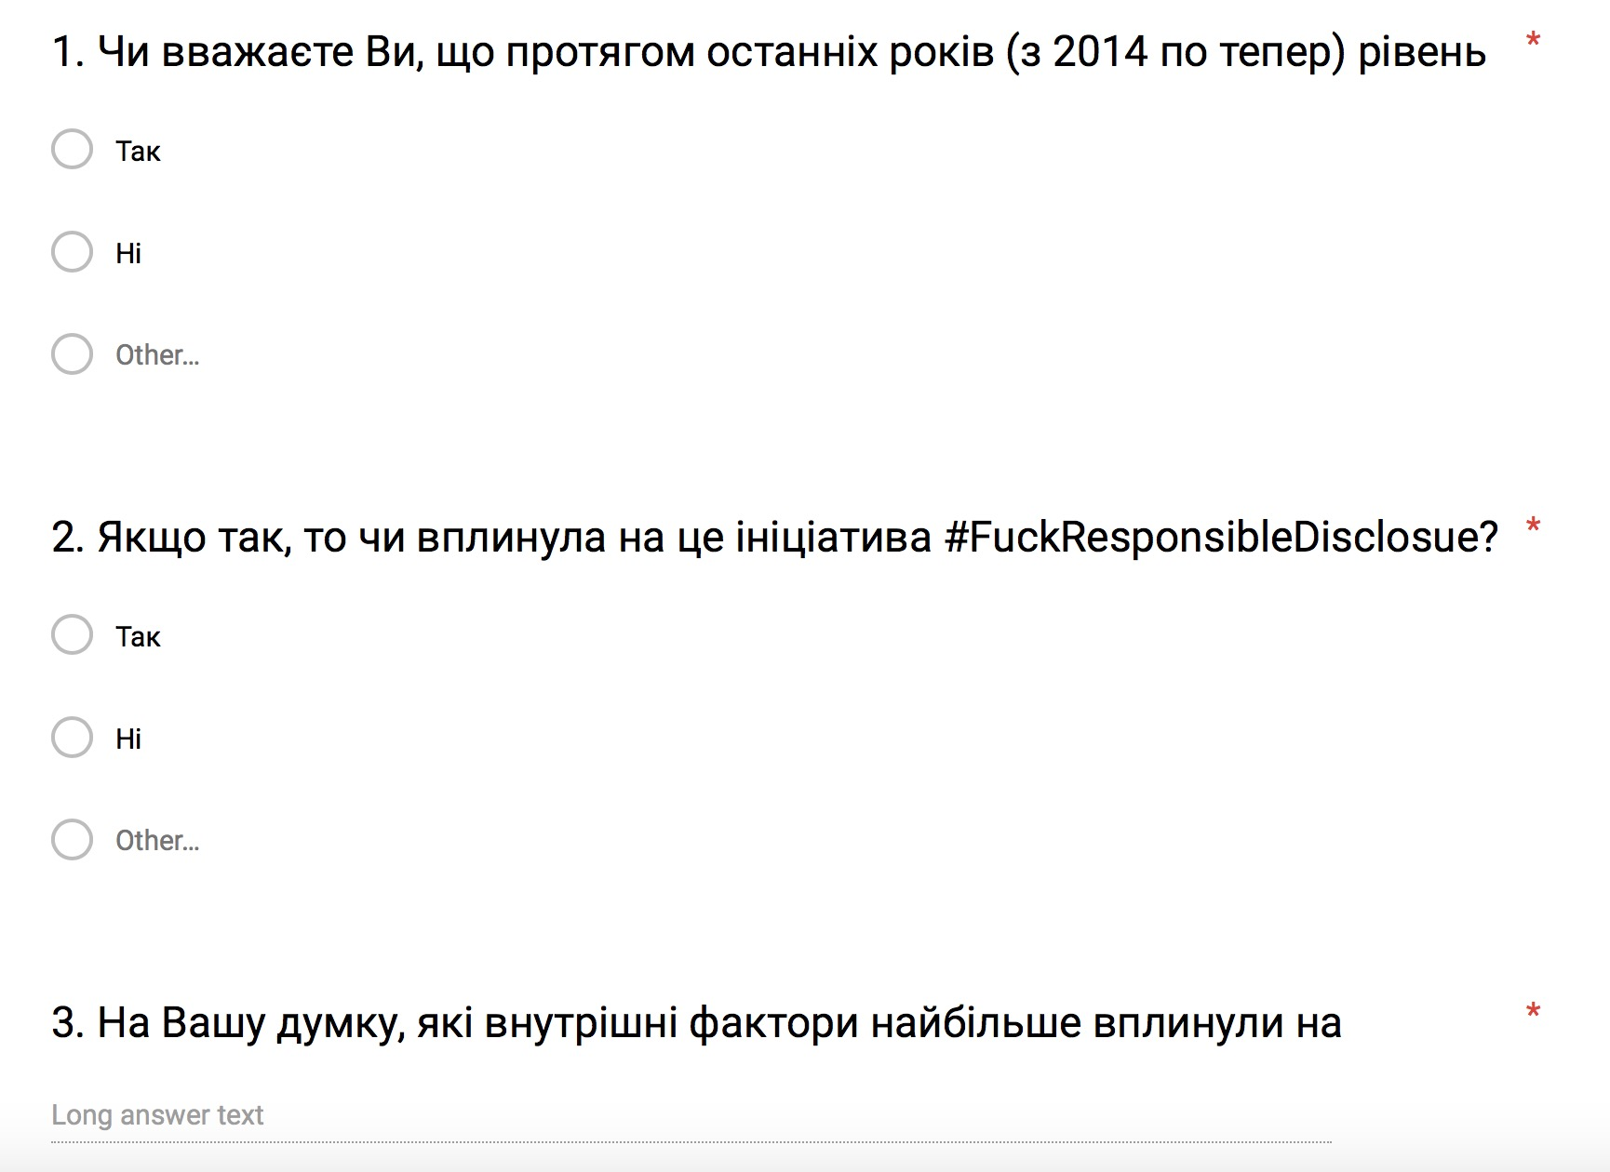
#FRD consequences
1.Do you believe that since 2014 cybersecurity level in Ukraine has been increased?
2. If so, has #FuckResponsibleDisclosure initiative influenced on it?
3. What factors in your opinion have influenced on current cybersecurity level in Ukraine the most?

Slide 55
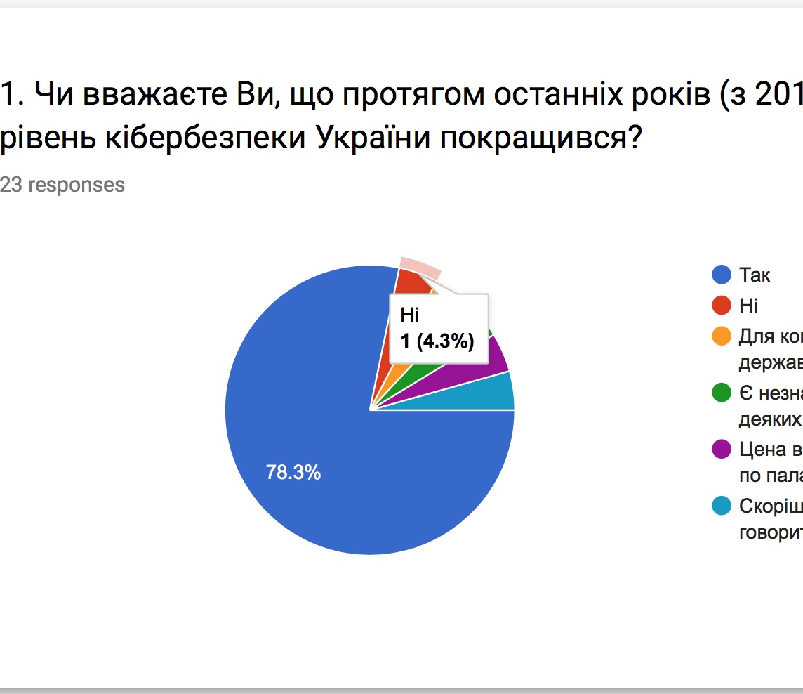
#FRD consequences
Question 1: Do you believe that since 2014 cybersecurity level in Ukraine has been increased?
YES: 78,3% NO: 4,3% Other: 17,4%

Slide 56
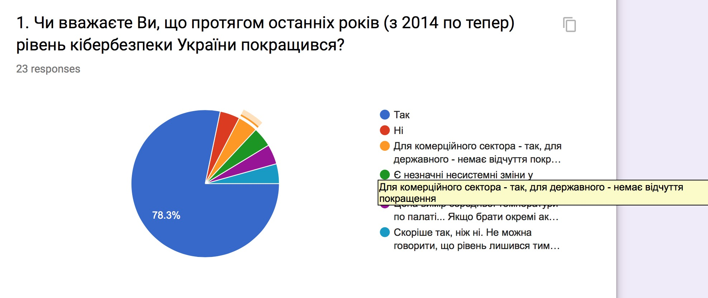
#FRD consequences
Question 1: Do you believe that since 2014 cybersecurity level in Ukraine has been increased?
For commercial sector: Yes
For Governmental sector: don’t think so

Slide 57
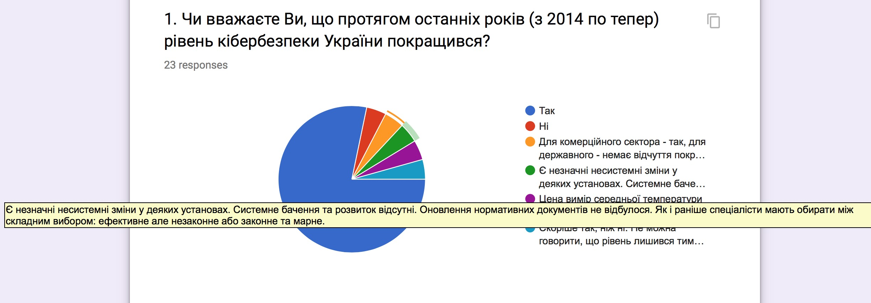
#FRD consequences
Question 1: Do you believe that since 2014 cybersecurity level in Ukraine has been increased?
Changes are insignificant,
in some organizations only

Slide 58
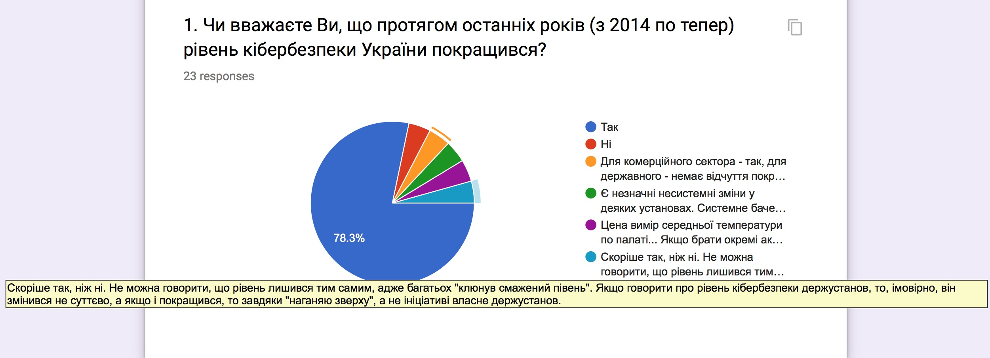
#FRD consequences
Question 1: Do you believe that since 2014 cybersecurity level in Ukraine has been increased?
Rather yes then no.
Cybersecurity level in Governmental/state organization has been increased unessentially

Slide 59
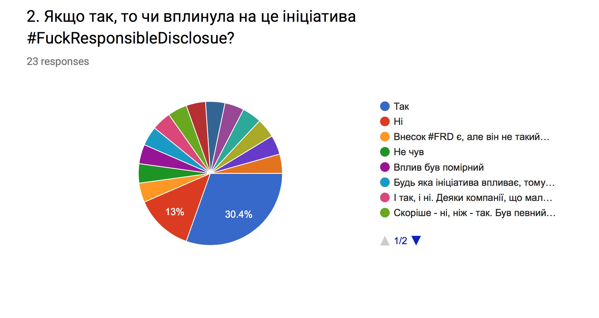
#FRD consequences
Question 2: If so, has #FuckResponsibleDisclosure initiative influenced on it?
Yes: 34,7%
No: 13%
It influenced partially: 21,5%
Influence was minor/moderate:12,9%
I haven’t heard on #FRD: 12,9%
I can’t say definitely: 5%

Slide 60
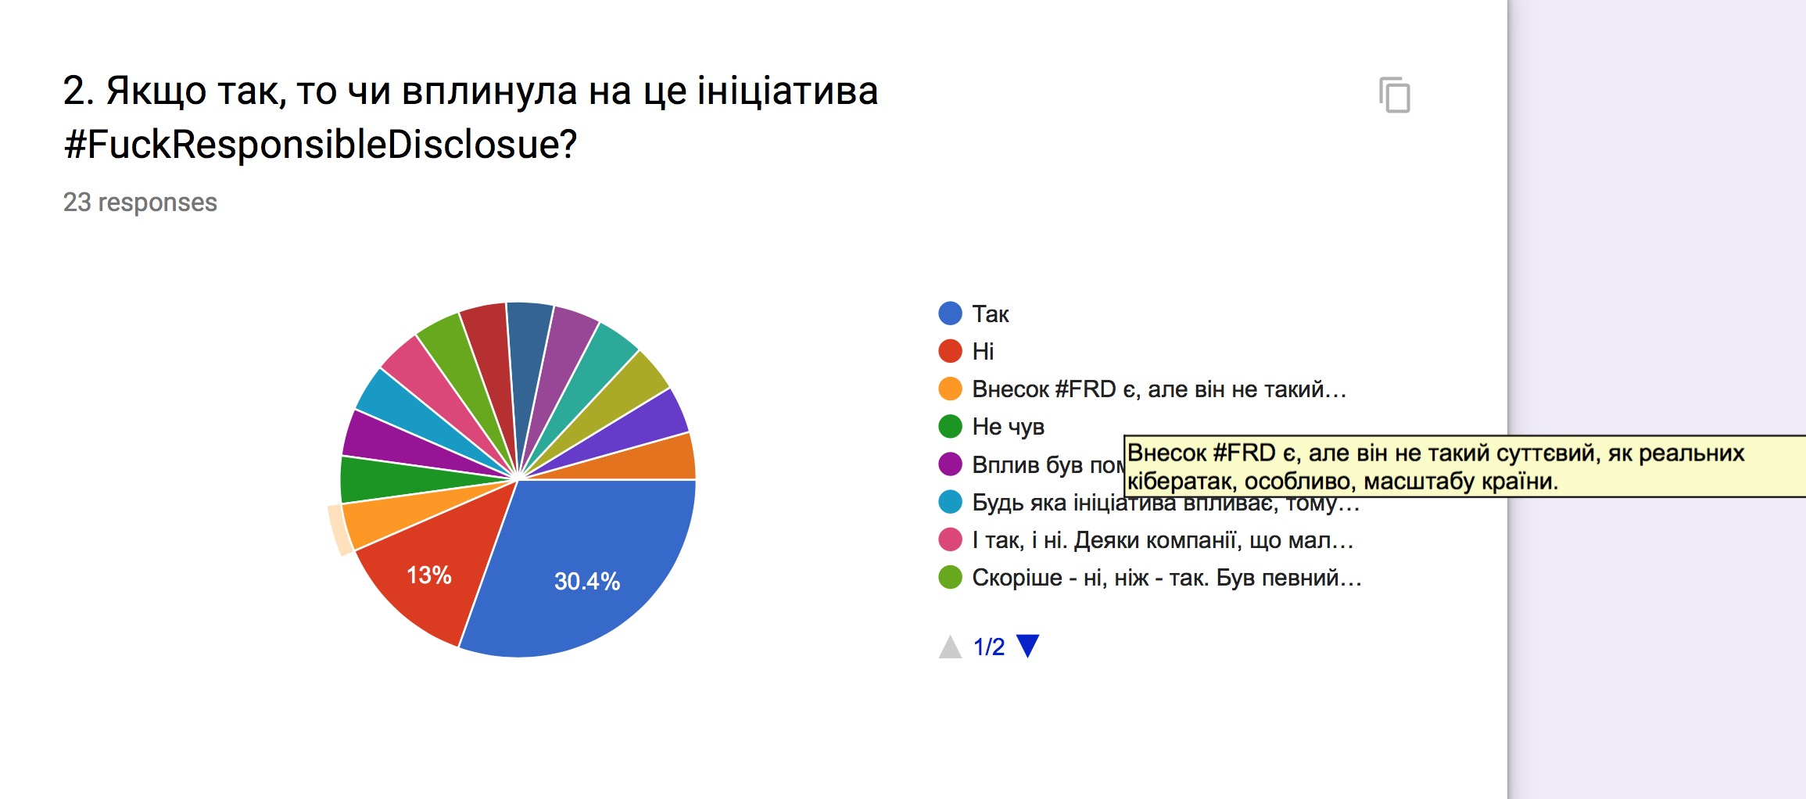
#FRD consequences
Question 2: If so, has #FuckResponsibleDisclosure initiative influenced on it?
#FRD contribution was minor

Slide 61
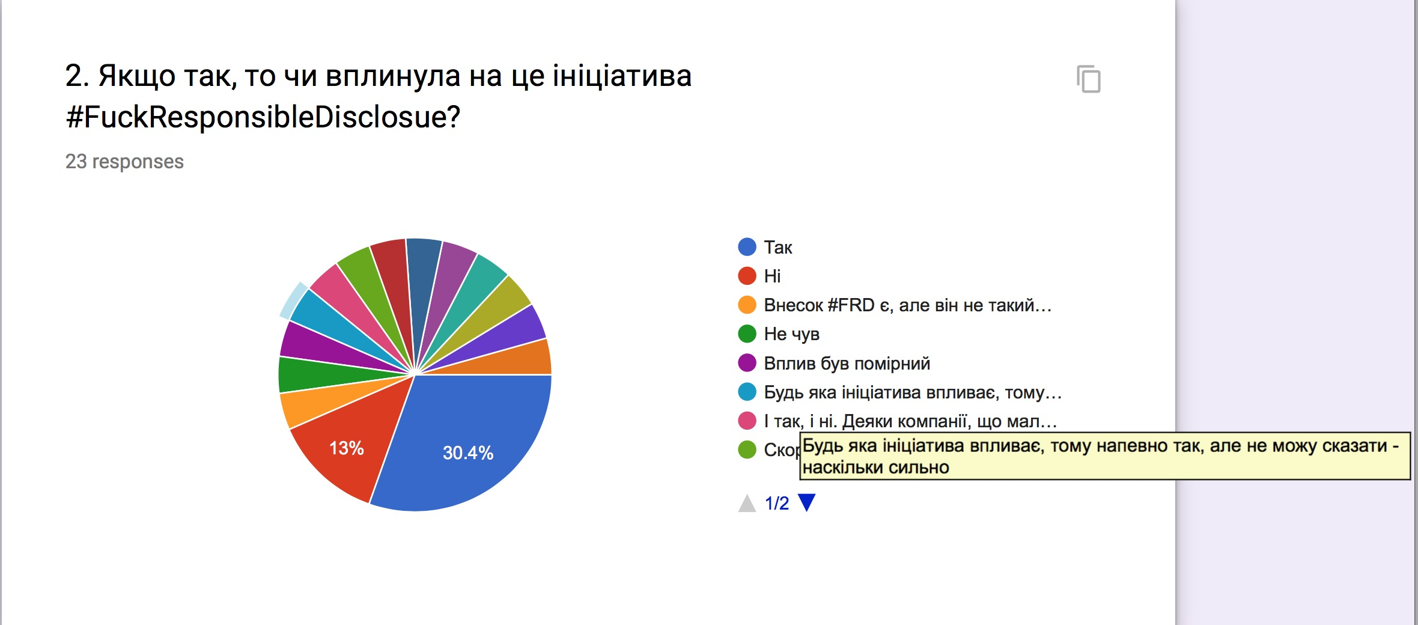
#FRD consequences
Question 2: If so, has #FuckResponsibleDisclosure initiative influenced on it?
Any initiative influences but I can’t say how strong

Slide 62
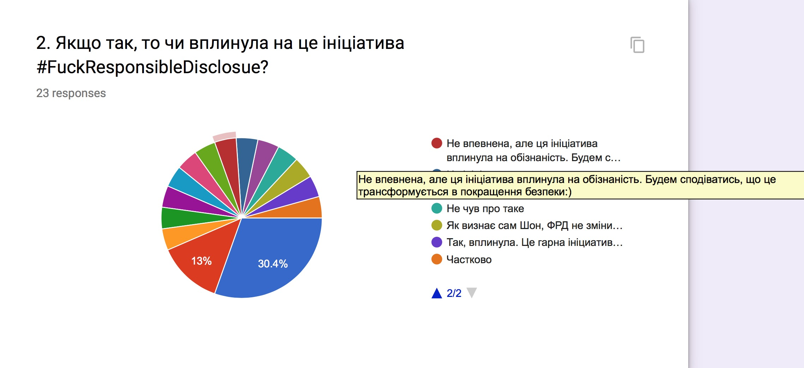
#FRD consequences
Question 2: If so, has #FuckResponsibleDisclosure initiative influenced on it?
I can’t be sure however probably the initiative influenced on cyber awareness

Slide 63
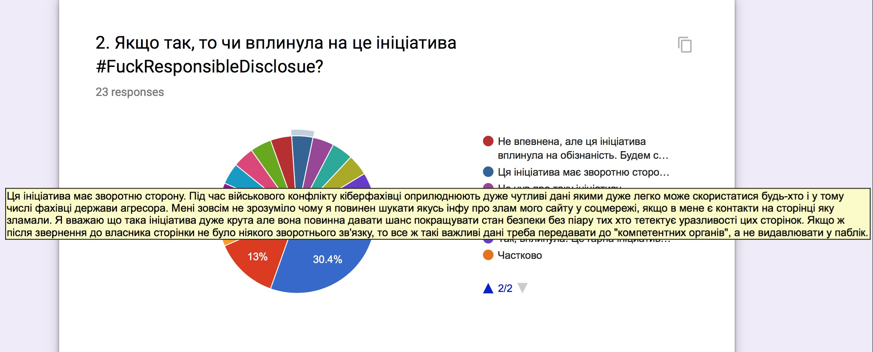
#FRD consequences
Question 2: If so, has #FuckResponsibleDisclosure initiative influenced on it?
The initiative has an opposite side: our country is in war any the adversary could use revealed vulnerabilities.
If an owner of vulnerable resources doesn’t response it would be better to let LEs know, not sharing in public.

Slide 64
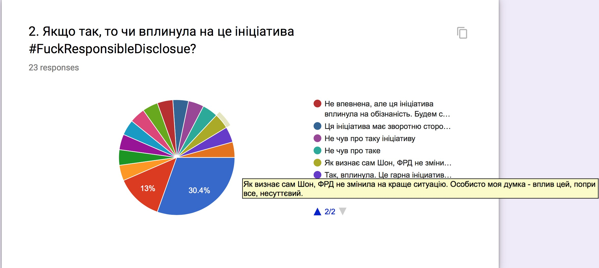
#FRD consequences
Question 2: If so, has #FuckResponsibleDisclosure initiative influenced on it?
#FRD’s initiative influenced inessentially, and Sean admitted that

Slide 65
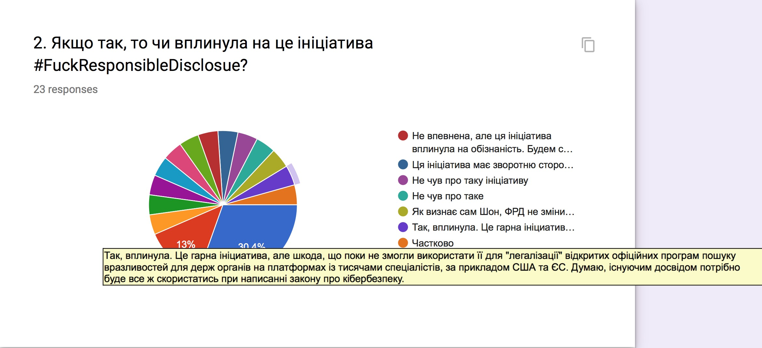
#FRD consequences
Question 2: If so, has #FuckResponsibleDisclosure initiative influenced on it?
Yes, #FRD has influenced. And this initiative must be used in upcoming Law on Cybersecurity in Ukraine

Slide 66
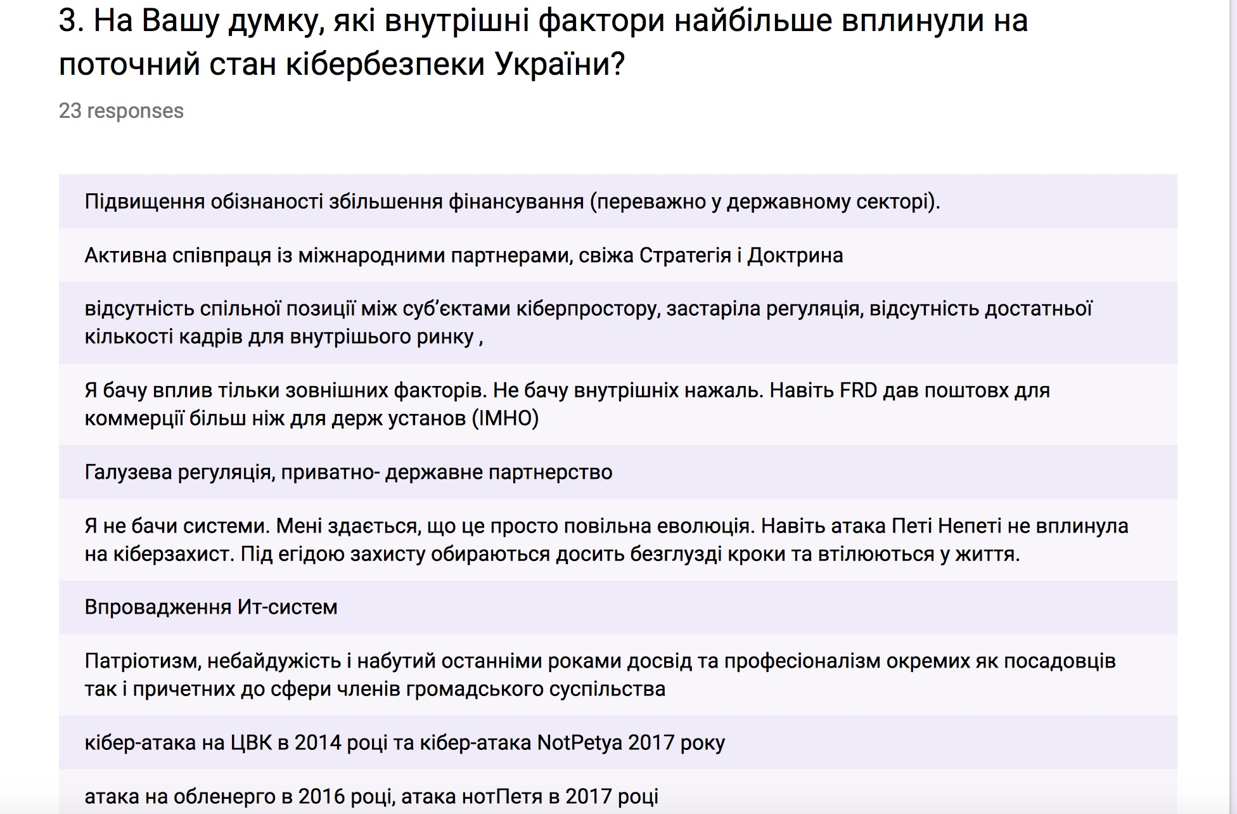
#FRD consequences
3. What factors in your opinion have influenced on current cybersecurity level in Ukraine the most?
NotPetya and most known cyberattacks
Why #FRD occurred?

Slide 67
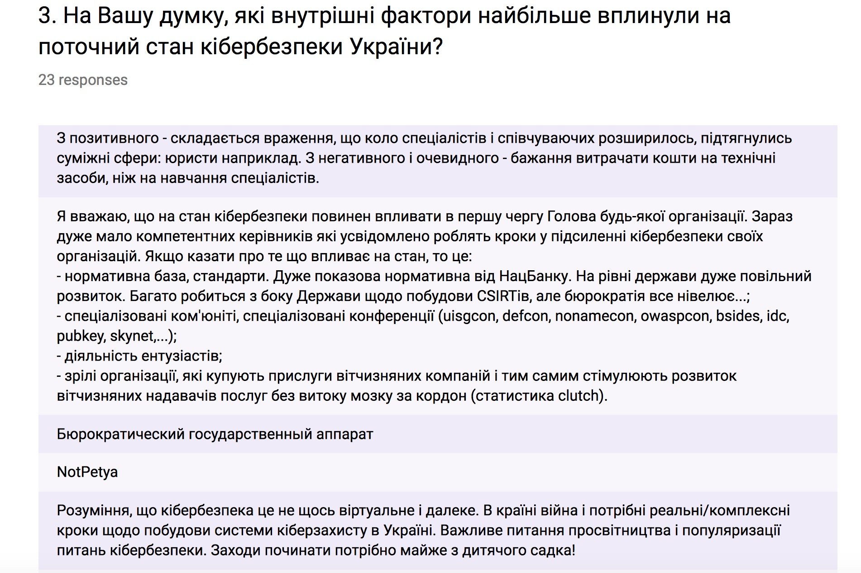
#FRD consequences
3. What factors in your opinion have influenced on current cybersecurity level in Ukraine the most?
What #FRD has led to?
Western Partners: not inner factor

Slide 68
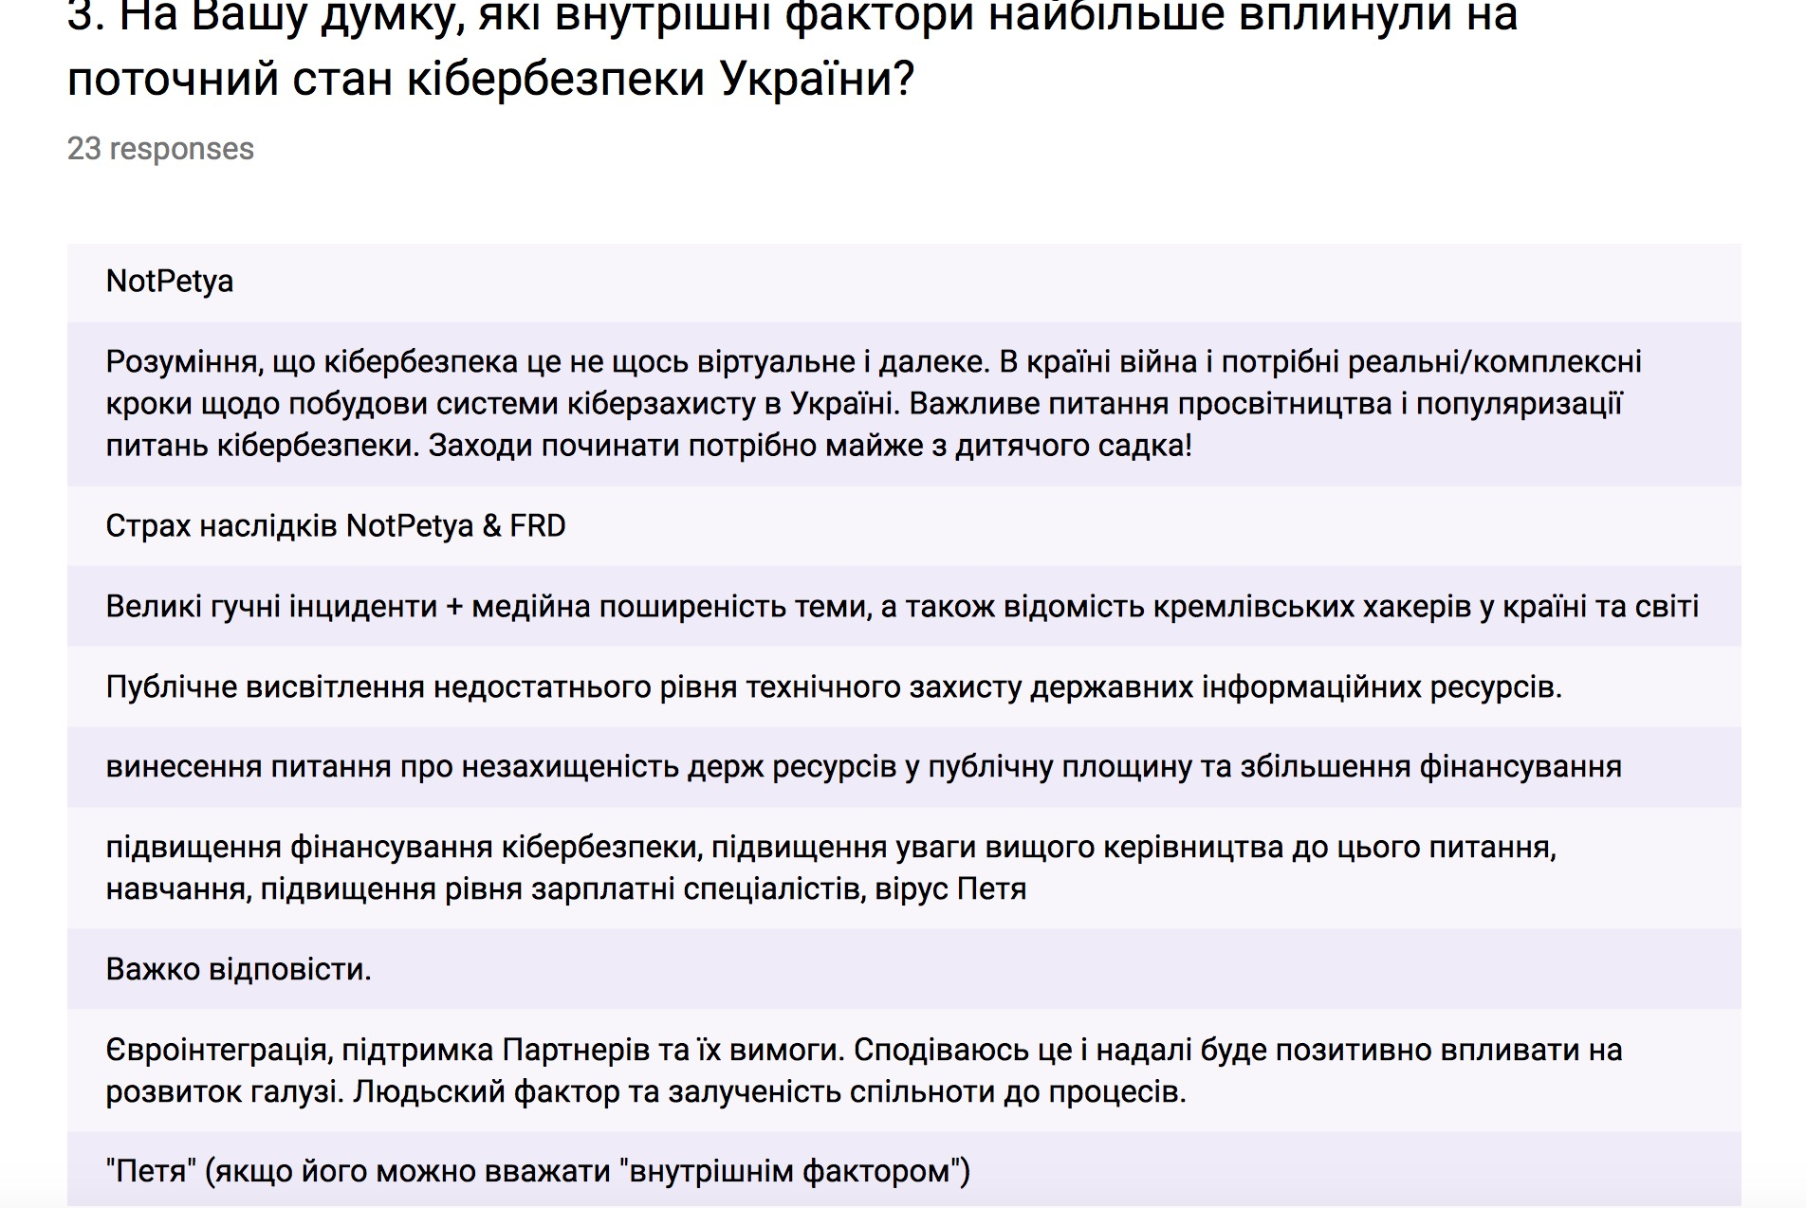
#FRD consequences
3. What factors in your opinion have influenced on current cybersecurity level in Ukraine the most?
No ’inner factors’ or ‘can’t say’ – honest answers
Only one hint at #FRD

Slide 69

#FRD consequences
So 23 best Ukrainian Cybersecurity experts believe that:
Cybersecurity level in Ukraine has increased: 78,3%
#FRD influenced on that significantly or partially: 56,2% BUT
#FRD was not a determined factor of that growth.

Slide 70

Conclusions
Question to myself: Main inner driver was marginal and hasn’t influenced whole country’s cybersecurity significantly?
Massive cyberattacks were a main driver?
#FRD is important initiative, but not enough effective? Any other idea?

Slide 71

Conclusions
#FRD is necessary and helpful
#FRD is not enough to influence whole country
#FRD needs to be changed; however it wouldn’t be #FRD
Government should do what #FRD does; but actually they don’t. #FRD is something bright, emotional, scandal, patriotic.
Thank you, #FRD

Slide 72

Q&A session?

Slide 73

Thank you! Please reach me out: kos@berezhasecurity.com https://berezhasecurity.com

